Slide 1
The ACE Minority Affairs Committee looks towards our second quarter century
The committee was created in 1991 as an ad hoc Committee on Minority Affairs
Victor J. Schoenbach, Ph.D., http://go.unc.edu/vjs
Department of Epidemiology and Minority Health Project
UNC Gillings School of Global Public Health
Presented at the American College of Epidemiology Minority Affairs Committee workshop, September 23, 2017
Notes:
Revised 9/21/2017

Slide 2
Outline
*History of the Minority Affairs Committee
Diversity in the epidemiology profession
A few thoughts on the current situation and challenges in definition and measurement
Ideas for the next quarter century

Slide 3
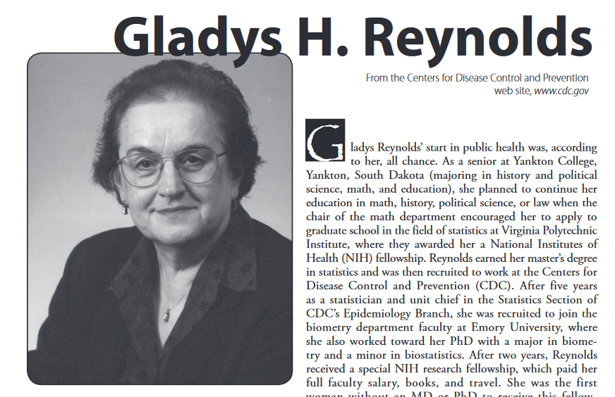
https://ww2.amstat.org/about/statisticiansinhistory/bios/reynoldsgladys.pdf
Notes:
In a very real sense, the ACE Minority Affairs Committee begins with Gladys Reynolds, who joined CDC in 1960 as the first woman Epidemic Intelligence Service Officer. She later became the first woman (and the first statistician) to serve as the head of a statistics branch at CDC, serving as chief of the Evaluation and Statistical Services Branch, Division of Sexually Transmitted Diseases from 1979–1989 and as senior statistician in the Office of Minority Health from 1989–2007.
She also served as president of the Association of Executive Women at CDC and a member of the CDC Equal Employment Opportunity Advisory Council in 1986–1987 and chaired CDC’s Affirmative Action Committee (1987). She was made a Fellow of the American College of Epidemiology in 1983 and was one of the original members of the ACE Committee on Minority Affairs, which she served on from 1991 to 1994 and then from 1995-1998 as liaison member to the American Statistical Association’s Statistics in Epidemiology Section, where she played a key leadership role.
Among her many achievements and distinctions, Reynolds received the CDC Award for Contributions to the Advancement of Women in 1986. In 1989 she was awarded the Women in Science and Engineering (WISE) Lifetime Achievement Award.

Slide 4
Bill Jenkins joins the Public Health Service Commissioned Corps in 1967
Notes:
Bill Jenkins was offered a position at the National Center for Health Statistics, either as a civil servant or in the PHS Commissioned Corps. He chose the latter, but when he reported to the Centers for Disease Control in Atlanta for his physical examination to enter the Public Health Service, the receptionist insisted that he was in the wrong place. When he tried to show her his orders and debate the issue, she called security. The NCHS then flew him up to Washington DC for his physical.
Gladys recounts that when she came to CDC in Atlanta there were few minorities and no African Americans there. In 1965 CDC recruited an African American EIS officer but they could not find a place for him to rent near CDC.
When Gladys Reynolds learned that Bill had come back to Atlanta from the D.C. area, she offered him a position at CDC and then became his mentor.

Slide 5
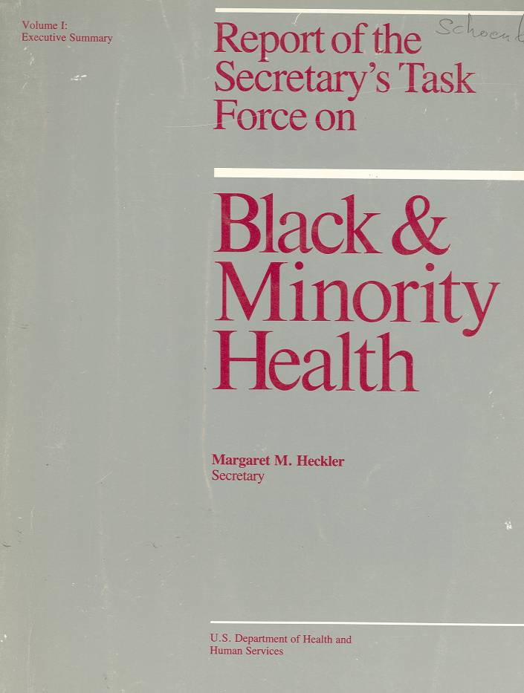
Putting disparities on the national public health agenda
W.E.B. Du Bois – The Philadelphia Negro
Booker T. Washington, The Negro Health Movement
Kerner Commission
APHA policy statements
Report of the Secretary’s Task Force (the “Heckler Report”)
Notes:
Perspectives in Disease Prevention and Health Promotion Report of the Secretary's Task Force on Black and Minority Health
MMWR February 28, 1986 / 35(8);109-12
http://www.cdc.gov/mmwr/preview/mmwrhtml/00000688.htm
http://www.nytimes.com/1985/10/17/us/minorities-seen-as-still-lagging-in-health-status.html?mcubz=3
The Task Force made eight main recommendations to the Secretary, each of which was followed by several specific suggestions:
1. Implement an outreach campaign, specifically designed for minority populations, to disseminate targeted health information, educational materials, and program strategies.
2. Increase patient education by developing materials and programs responsive to minority needs and by improving provider awareness of minority cultural and language needs.
3. Improve the access, delivery, and financing of health services to minority populations through increased efficiency and acceptability.
4. Develop strategies to improve the availability and accessibility of health professionals to minority communities through communication and coordination with nonfederal entities.
5. Promote and improve communication and coordination among federal agencies in administering existing programs for improving the health status and availability of health professionals to minorities.
6.Provide technical assistance and encourage efforts by local and community agencies to meet minority-health needs.
7.Improve the quality, availability, and use of health data pertaining to minority populations.
8. Adopt and support research to investigate factors affecting minority health, including risk-factor identification, education interventions, and prevention and treatment services.

Slide 6
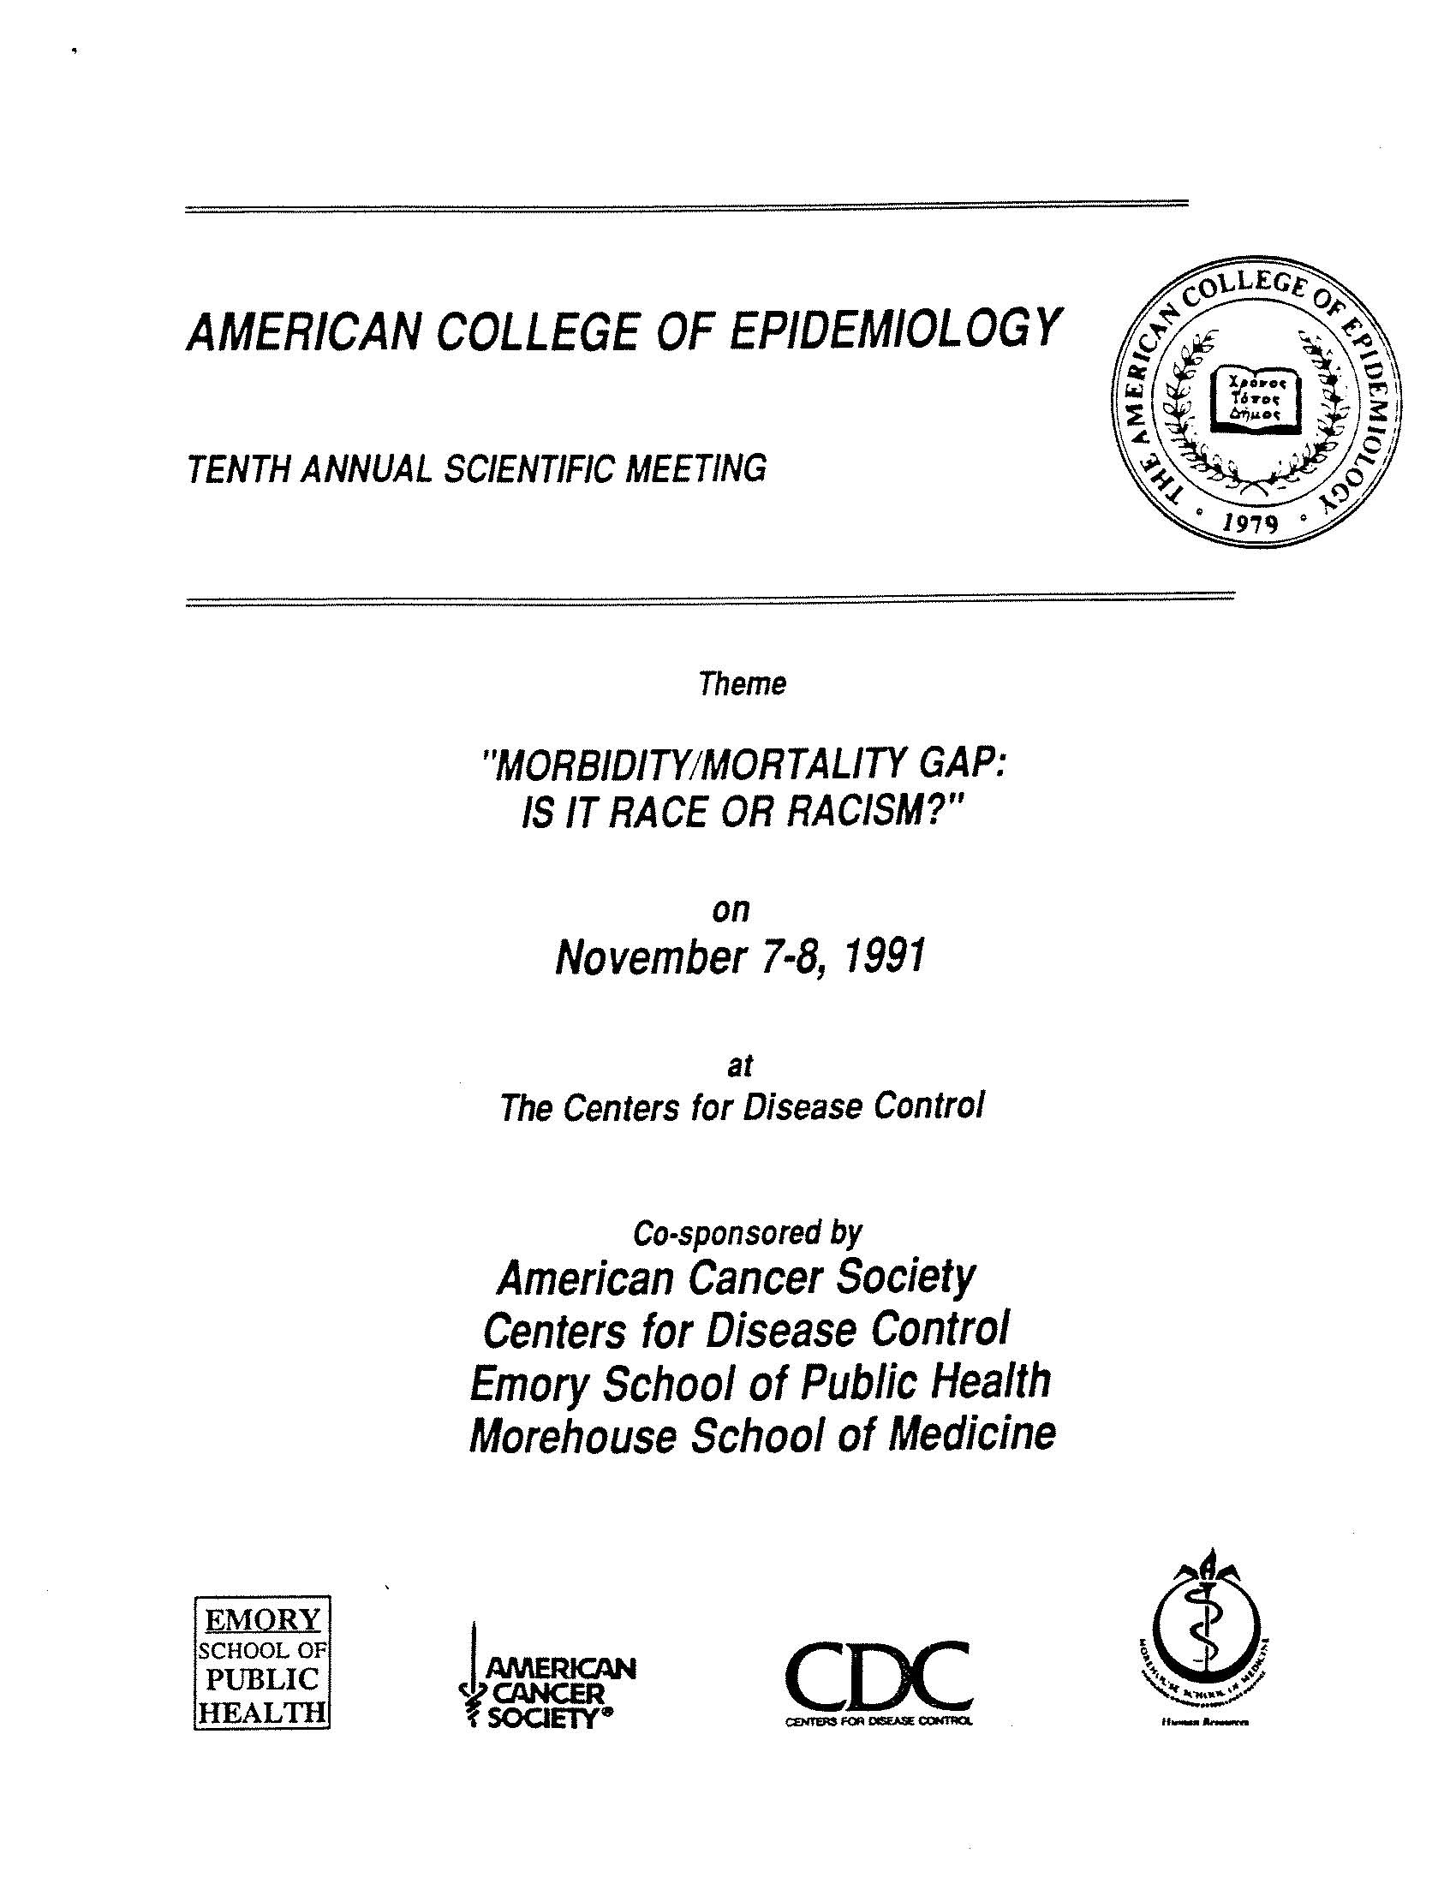
ACE 10th Annual Scientific Meeting, 1991 in Atlanta, GA
Morbidity/Mortality Gap:
Is it Race or Racism?”
A consciousness-raising experience
Notes:
The 10th Annual Scientific Meeting of the American College of Epidemiology was a significant landmark is the history of the movement to eliminate racial/ethnic health disparities in the U.S. The 1991 meeting was co-sponsored by the American Cancer Society, the Centers for Disease Control, the Emory University School of Public Health, and Morehouse School of Medicine. The meeting was held at CDC headquarters in Atlanta. The weekend that followed had two related events, including the founding meeting of the Society for the Analysis of African American Public Health Issues (SAAPHI). During its 25 years as an APHA-related organization, SAAPHI has had a major impact on APHA and U.S. public health policy in relation to health disparities. The APHA annual meeting took place the following week.
For many of us, the program was a consciousness-raising experience.
The CDC notice of the November 7-8, 1991 meeting is at http://www.cdc.gov/mmwr/preview/mmwrhtml/00001973.htm

Slide 7
“Morbidity/Mortality Gap: Is it Race or Racism?”
Program Committee:
Gladys Reynolds (chair)
Bill Jenkins (co-chair)
James Ferguson
Terry Fontham
Eugene Gangarosa
Clark Heath
Sherman James
Manuel Torres-Anjel
Notes:
ACE President Ray Greenberg asked Gladys Reynolds to chair the program committee. She agreed, contingent on Bill Jenkins serving as co-chair. Eugene Gangarosa proposed the attention-catching second half of the theme, giving a significant boost to efforts to put racism on the epidemiologic research agenda.

Slide 8
President’s remarks
"By initiating this forum, the American College of Epidemiology hopes to move the agenda forward and to reaffirm our commitment to the improvement of health for all people."
Raymond S. Greenberg, M.D., Ph.D.
(Annals of Epidemiology March 1993;3(2):125)
Notes:
In his Introductory Comments (page 125), Ray Greenberg wrote:
The theme of this meeting, “Morbidity/Mortality Gap: Is It Race or Racism?”, was selected after the ninth annual meeting of the College, which was organized around health concerns at various stages of life. One of the dominant themes in each and every presentation was the tremendous ethnic diversity of health experience at each phase of life. It became very clear that focusing on these racial and ethnic differences was central to the role of epidemiology.…
In this country we have seen the emergence of an underclass that suffers disproportionately a variety of social, economic, and health consequences. We are also witnessing a crisis in the public health system in the United States as it struggles to meet those needs. As professionals in public health, we can no longer stand by and observe these inequities as dispassionate observers. We need to be involved in asking the difficult questions and looking for viable solutions. This conference is an attempt to begin to answer some of those difficult questions.…
To begin to solve the kinds of problems under discussion, we need to have greater knowledge and exchange of information. Moreover, it will be necessary to develop better interventions, stimulate more public attention, and also attract greater resources. By initiating this forum, the American College of Epidemiology hopes to move the agenda forward and to reaffirm our commitment to the improvement of health for all people.

Slide 9
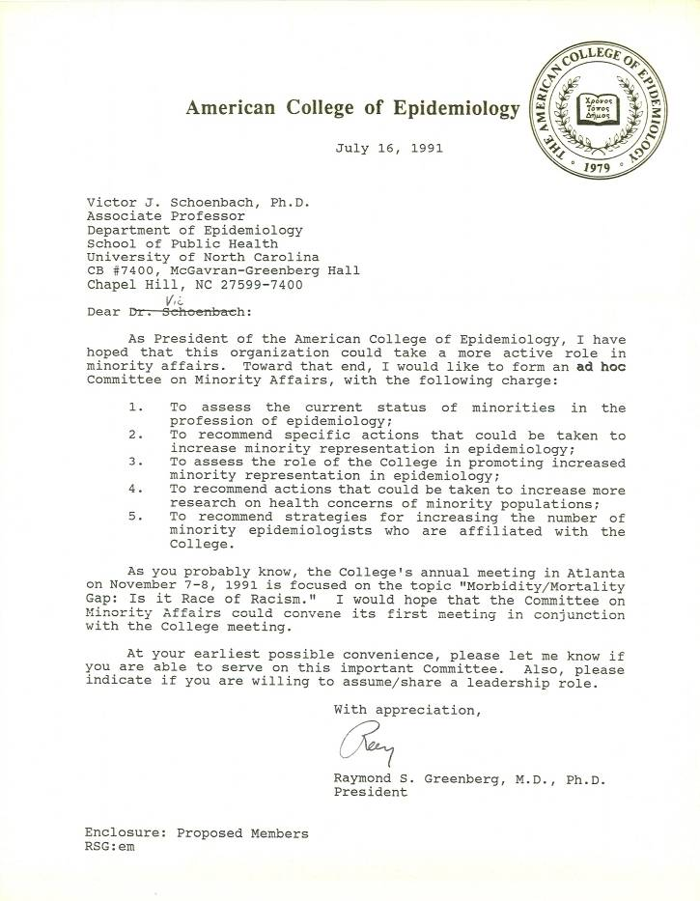
ACE President forms ad hoc Committee on Minority Affairs
“As President of the American College of Epidemiology, I have hoped that this organization could take a more active role in minority affairs.”
Raymond S. Greenberg, MD, PhD
Notes:
In 1991, the ACE was still trying to define its role in the profession. One of the basic motivations for creating the College, credentialing of non-physician epidemiologists, was being rethought. Few people had taken the credentialing examination, and the value of the credential was uncertain. But without the certification exam, what was the College’s raison-d’etre? At the same time, the College was the only epidemiology organization whose primary focus was serving the needs of practicing epidemiologists and at the time the only one willing and able to take official policy positions. The major initial policy thrust was about professional ethics. President Raymond Greenberg and others felt that racial disparities in health would be another policy area for which the organization might take leadership, and through which it could engage members who were not particularly motivated by the ethics issue.
So with enthusiastic support from the Board of Directors, President Greenberg created an ad hoc Committee on Minority Affairs. He put out a call to members seeking volunteers. I was one of those who responded, and Ray asked if I would serve as chair and convene an initial meeting in conjunction with the 1991 Annual Scientific Meeting. I objected, saying that someone like Sherman James should probably be chair. But when I asked Sherman, he said that I should be chair since I would follow his advice and he wouldn’t have to devote as much time! On that basis I agreed.

Slide 10
Charge to the Committee
Assess current status of minorities in the profession of epidemiology;
Recommend specific actions to increase minority representation;
Assess the role of the College in promoting increased representation;
Recommend actions to increase research on minority health;
Recommend strategies for increasing minority epidemiologists in ACE.
Notes:
(From Report from Ad Hoc Committee on Minority Affairs to Alan Hinman, August 20, 1993)
The Committee's charge is to:
1. Assess the current status of minorities in the profession of epidemiology;
2. Recommend specific actions to increase minority representation in epidemiology;
3. Assess the role of the College in promoting increased minority representation in epidemiology;
4. Recommend actions to increase research on health concerns of minority populations;
5. Recommend strategies for increasing the number of minority epidemiologists who are affiliated with the College.

Slide 11
Early members (as of 8/1993)
Lucile Adams-Campbell
James A. Ferguson
Sherman A. James
Bill Jenkins
Shiriki Kumanyika
Vickie M. Mays
John T. Nwangwu
Gladys H. Reynolds
Victor J. Schoenbach
Grethe S. Tell
Glenn Solomon (joined Oct 1995)
Notes:
Stephen Blount was on the initial committee list – Vic can’t recall if he attended the first meeting or not but had little or no participation thereafter.
Manuel Torres-Anjel was on the initial committee but resigned in Jan 1993
Shiriki was originally an “observer”, since she was not a member of the College and debated whether or not to join (correct?)

Slide 12
Liaison members
C. Perry Brown (APHA)
Lucina Suarez (SER #1)
Camara P. Jones (SER #2)
Shiriki Kumanyika (AHA EPID Council)
John T. Nwangwu (ATPM)
Gladys Reynolds (ASA Epid Section)
Notes:
One of the first steps the committee did was to request the addition of formal liaison members from other epidemiology organizations, by asking the ACE President (then Patricia Buffler) to write to the heads of other EPID societies asking them to designate a liaison. Lucina was the first SER liaison and was later replaced by Camara.

Slide 13
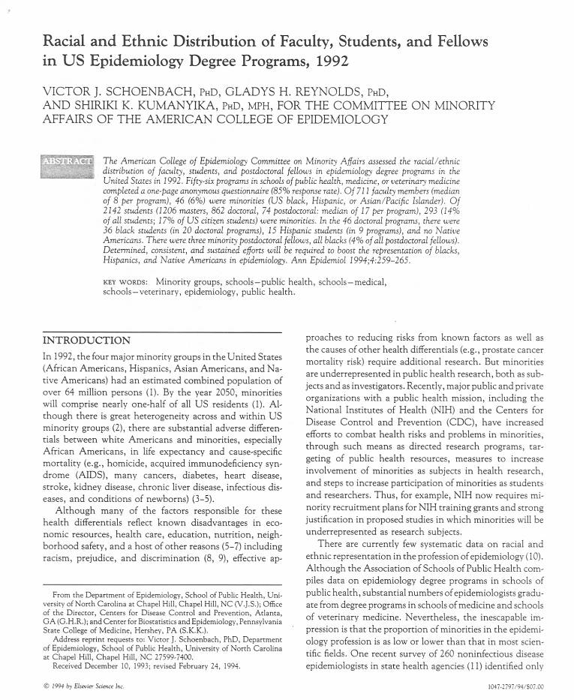
Study #1 - survey of race and ethnicity in US epidemiology
56/66 epidemiology degree programs in US schools of public health, medicine, veterinary medicine
1 page questionnaire
Report full-time faculty, students as of April 1992
Notes:
The American College of Epidemiology Committee on Minority Affairs conducted a 1992 survey of racial/ethnic distribution in academic epidemiology, published in the Annals of Epidemiology in 1994 along with a commentary by the 1991 ACE President.

Slide 14
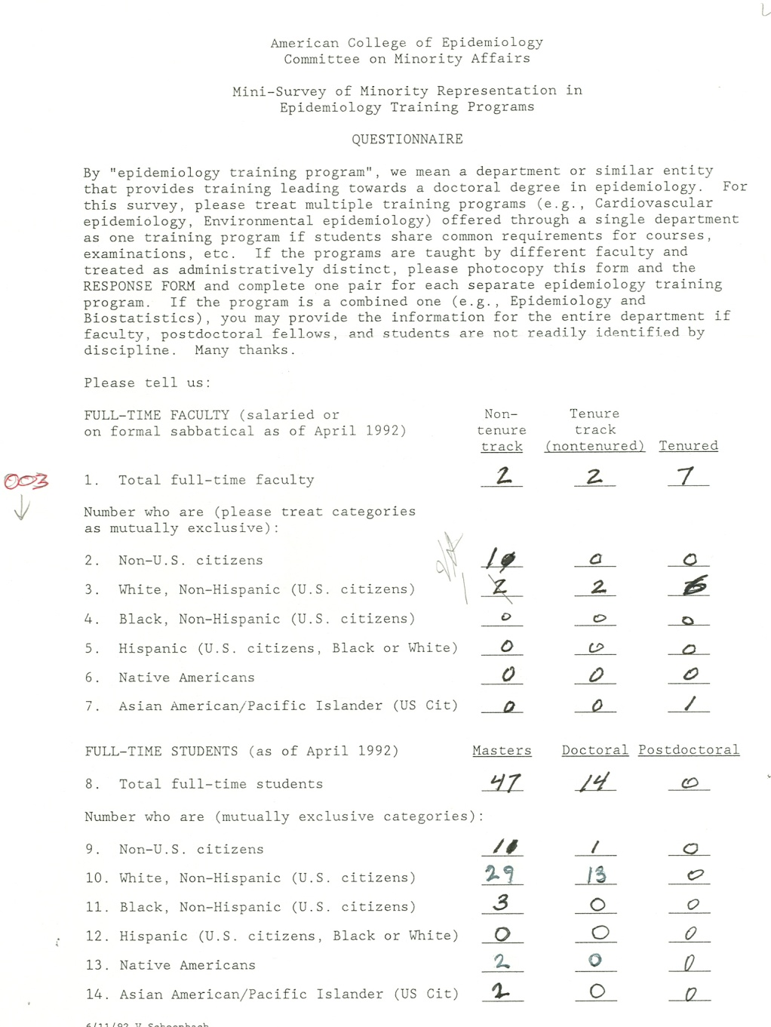

Slide 15
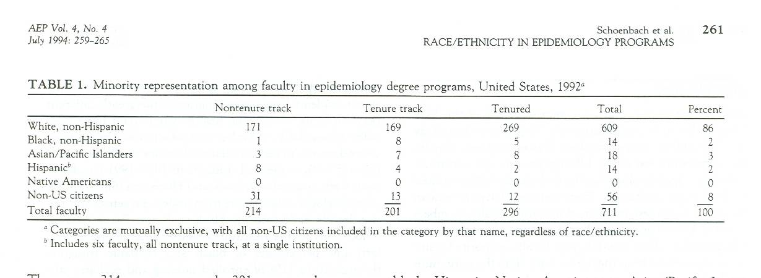
Survey results - faculty
711 total faculty
14 Black (non-Hispanic) (2%)
14 Hispanic (incl. 6 at one instit.) (2%)
0 American Indians / Native Americans
Notes:
The 711 total faculty included 56 non-US citizens, included in the denominator for the percentages. Of these totals, there were 296 tenured (5 black, 2 Hispanic), 201 tenure-track (8 black, 4 Hispanic), and 214 non-tenure-track (1 black, 8 Hispanic).

Slide 16
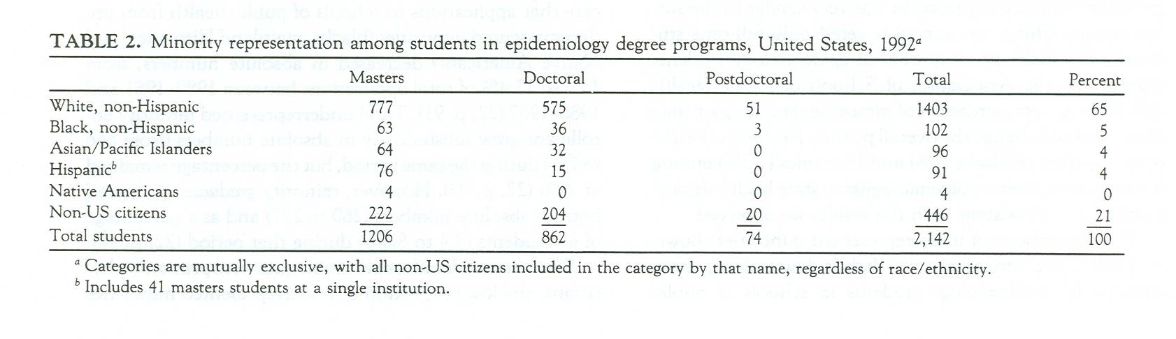
Survey results - students
2,142 students
102 Black (non-Hispanic) (5%)
91 Hispanic (incl. 41 at one instit.) (4%)
4 American Indians / Native Americans
Notes:
The 2142 total students included 446 non-US citizens, included in the denominator for the percentages. Of these totals, there were 1206 masters students ( tenured (63 black, 76 Hispanic, 4 American Indian), 862 doctoral (36 black, 15 Hispanic), and 74 postdoctoral fellows (3 black).

Slide 17
Survey recommendations
Epidemiology’s mission should include advancement of minority health / minority epidemiologists.
Study minority health problems and solutions; study racism.
Conduct vigorous outreach to make epidemiology careers and financial aid opportunities more visible to minorities.
Provide ample, stable funding for minority training and supportive educational environments, plus networks of minority epidemiologists.
Federal programs (e.g., MARC, MBRS, HCOP) should expand their coverage of epidemiology research and training; more programs should be created like the CDC's Project IMHOTEP.
Professional development opportunities should include diversity training related to the review of applications for admission, applications for grants, submitted manuscripts, etc.
A body analogous to the AAMC Division of Minority Health, Education, and Prevention should be provided a mandate and resources to monitor progress in increasing the role of underrepresented minorities in epidemiology. Recognize/support/reward epidemiologists who make exceptional contributions.
Notes:
Recommendations:
1. The mission of epidemiology organizations should include advancement of minority health and of minority epidemiologists and trainees in professional, educational, corporate, and governmental settings. Institutional commitment should be expressed in the leadership provided by deans, directors, and chairs, in effective actions, in provision of resources, and in increased diversity.
2. Greater attention should be given in epidemiology journals and scientific meetings to studies that address minority health problems with insight and cultural sensitivity, and especially, that identify potential solutions to these problems. Epidemiology forums should also invite studies on the nature of, effects of, and interventions to reduce racism, both individual and institutional (8,9).
3. A vigorous outreach campaign is needed to make epidemiology careers, pathways to them, and financial aid opportunities more visible in minority educational institutions and minority communities. The potential of minority recruitment activities is illustrated by a program at the CDC EIS, where minority representation among trainees rose from 11 percent in the 1980's to 17 percent in the 1990 EIS class and 26 percent in the 1991 class (23).

Slide 18
Survey recommendations
Epidemiology’s mission should include advancement of minority health / minority epidemiologists.
Study minority health problems and solutions; study racism.
Conduct vigorous outreach to make epidemiology careers and financial aid opportunities more visible to minorities.
Notes:
Recommendations:
1. The mission of epidemiology organizations should include advancement of minority health and of minority epidemiologists and trainees in professional, educational, corporate, and governmental settings. Institutional commitment should be expressed in the leadership provided by deans, directors, and chairs, in effective actions, in provision of resources, and in increased diversity.
2. Greater attention should be given in epidemiology journals and scientific meetings to studies that address minority health problems with insight and cultural sensitivity, and especially, that identify potential solutions to these problems. Epidemiology forums should also invite studies on the nature of, effects of, and interventions to reduce racism, both individual and institutional (8,9).
3. A vigorous outreach campaign is needed to make epidemiology careers, pathways to them, and financial aid opportunities more visible in minority educational institutions and minority communities. The potential of minority recruitment activities is illustrated by a program at the CDC EIS, where minority representation among trainees rose from 11 percent in the 1980's to 17 percent in the 1990 EIS class and 26 percent in the 1991 class (23).

Slide 19
Survey recommendations
Provide ample, stable funding for minority training and supportive educational environments, plus networks of minority epidemiologists.
Federal programs (e.g., MARC, MBRS, HCOP) should expand their coverage of epidemiology research and training; more programs should be created like the CDC's Project IMHOTEP.
Notes:
(Recommendations, continued)
4. Since minority epidemiology students are more likely to come from socioeconomically stressed situations and less likely to be able to identify role models among the faculty, recruitment activities should be supported by ample, stable funding for minority epidemiology training and by supportive educational environments with informed and culturally sensitive advising and feedback. Networks of minority epidemiologists and students across institutions are helpful for informal support, information sharing, and mentoring, since the actual numbers of minorities within most individual institutions will continue to be relatively low for some time to come.
5. The various federal programs aimed at attracting underrepresented minorities to biomedical research and the health professions (including Minority Access to Research Careers [MARC], Minority Biomedical Research Support [MBRS], Health Careers Opportunity Program [HCOP], and the minority predoctoral fellowship program of the National Institute of General Medical Sciences - see [17]) should expand their coverage of epidemiology research and training. More programs should be created like the CDC's Project IMOTEP, . . . given record numbers of minority students applying to medical school, the AAMC's "Project 3000 by 2000", and the advantages that medical training provides for epidemiologists. A recent proposal for providing research training for selected minority students and research fellowships after residency (17) could readily be adapted to include epidemiology.

Slide 20
Survey recommendations
Professional development opportunities should include diversity training related to the review of applications for admission, applications for grants, submitted manuscripts, etc.
A body analogous to the AAMC Division of Minority Health, Education, and Prevention should be provided a mandate and resources to monitor progress in increasing the role of underrepresented minorities in epidemiology. Recognize/support/reward epidemiologists who make exceptional contributions.
Notes:
Recommendations:
6. Professional development opportunities for epidemiologists and those who manage them should include diversity training. Diversity issues related to the review of applications for admission, applications for grants, and manuscripts submitted for publication should also be considered. Current requirements, criteria, and procedures tend to favor established nonminority over less-established minority applicants, researchers, and authors, even where the minority group members have more access to, experience with, and insight into the populations of interest.
7. A body analogous to the AAMC Division of Minority Health, Education, and Prevention but representing the epidemiology profession should be provided a mandate and resources to monitor progress in increasing the role of underrepresented minorities. Mechanisms to recognize, support and reward epidemiologists who make exceptional contributions to improving minority representation should be established.

Slide 21
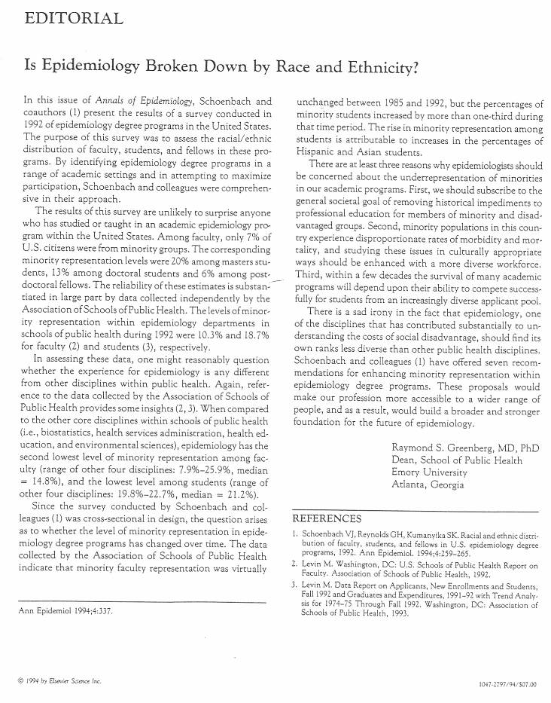
Annals of Epidemiology editorial by Ray Greenberg
“These proposals would make our profession more accessible to a wider range of people, and as a result, would build a broader and stronger foundation for the future of epidemiology.”

Slide 22
Recommendations to the ACE Board of Directors
“Vic, this is a very powerful statement. I never imagined (in my more than 20 yrs in epidemiology) that I would see such a powerful statement emerging from an Epid organization. It will be more than just a little interesting to see the Board's reactions.”

Slide 23
Recommendations* to the ACE Board of Directors, March 1994
The Board of Directors should publish a statement of principles recognizing (a) the importance of minority health and (b) the need for diversity. The statement should commit the Board to reporting annually on progress.
* The recommendations were presented to the Board at their
March 6, 1994 meeting and modified to the ones presented here.
The text has been abbreviated for the slides. See the speaker notes for the full text.
Notes:
Document history: Drafted by John Nwangwu and Gladys Reynolds, revised by Vic Schoenbach in the course of telephone conference call discussions; modified 7/19/94 to reflect the discussion at the March 6, 1994 ACE Board of Directors meeting. At that meeting, the recommendations as revised were approved by the Board of Directors.
Recommendations:
1. The Board of Directors should publish a statement of principles and goals that recognizes (a) the importance of minority health and (b) the need for diversity. The statement should commit the Board to reporting annually on progress in diversifying the membership and committees of the College.

Slide 24
Recommendations to the ACE Board of Directors, March 1994
Organizers, speakers, and participants in the Annual Meeting should reflect greater diversity; the program should regularly cover minority health.
Notes:
2. Organizers and participants in the Annual Meeting should reflect greater diversity; the program should regularly cover minority health; speakers should come from different racial/ethnic groups. Scholarships should facilitate attendance. The meeting should regularly feature a session(s) on minority issues.

Slide 25
Recommendations to the ACE Board of Directors, March 1994
The application fee should be discontinued for all applicants as it appears to be a disincentive for applying, particularly for persons who are ambivalent about joining or uncertain about their prospects for acceptance.
Notes:
3. The application fee should be discontinued for all applicants as it appears to be a disincentive for applying, particularly for persons who are ambivalent about joining or uncertain about their prospects for acceptance.

Slide 26
Recommendations to the ACE Board of Directors, March 1994
The dearth of minorities at all levels of the College should be rectified. The College should work actively to sensitize the membership to the issues of racism, sexism, homophobia, xenophobia, and classism.
Notes:
4. The dearth of minorities at all levels of the College should be rectified. The College should work actively to sensitize the membership to the issues of racism, sexism, homophobia, xenophobia, and classism and present training and/or articles on the need for equal opportunity at all levels of the organization.

Slide 27
Recommendations to the ACE Board of Directors, March 1994
The Committee on Minority Affairs should become a standing committee of the College, to contribute to the realization of the statement of principles and the Committee’s original charge.
Notes:
5. The Committee on Minority Affairs should become a standing committee of the College, to contribute to the realization of the statement of principles and the Committee’s original charge. A member of the Board of Directors should serve on the Committee.

Slide 28
Recommendations to the ACE Board of Directors, March 1994
The Committee on Minority Affairs should establish and maintain liaisons with SER, the epidemiology sections of APHA and ASA, the AHA Council on Epidemiology and Prevention, other committees of the College, and other agencies.
Notes:
6. The Committee on Minority Affairs should establish and maintain liaisons with SER, the epidemiology sections of APHA and ASA, the AHA Council on Epidemiology and Prevention, other committees of the College, and other agencies.

Slide 29
Draft Statement of Principles, proposed to Board, Sept 1994
Board accepts the recommendations.
President G. Marie Swanson invites the Committee on Minority Affairs to draft the Statement of Principles.
Notes:
I believe that John Nwangwu proposed having a Statement of Principles.

Slide 30
Draft Statement of Principles, Sept 1994 – Synopsis - 1
Health and life for any group increasingly depend upon health and wellbeing of all.
Epidemiology remains largely the province of men of European descent and has a long distance to travel toward diversity, with important obstacles and barriers.
Forces that maintain dominance are numerous, deeply embedded, and unseen by many, including psychological racism.
Notes:
Here is a synopsis of the statement drafted by the Committee and presented to the Board in September 1994:
We can now see the potential for health and longevity to be more widely enjoyed than ever before.
Health and life for any group increasingly depend upon health and wellbeing of all.
Epidemiologists have responsibility to maintain high public awareness of the reservoir of preventable disease.
Epidemiologists are particularly cognizant of need for new knowledge to control disease in all peoples. Diverse factors affect health, as do discrimination and persecution.
Leadership from epidemiologists in systematic study of minority health issues is particularly critical with evolving meaning of race/ethnicity.
Epidemiology remains largely the province of men of European descent and has a long distance to travel toward diversity, with important obstacles and barriers.
Forces that maintain dominance are numerous, deeply embedded, and unseen by many, including psychological racism.

Slide 31
Draft Statement of Principles, Sept 1994 – Synopsis - 2
. . . Competitive meritocracy presupposes adequate access to the means to compete, reinforces past advantages, and tends to preserve historic inequity.
. . . In view of pervasive, longstanding, disadvantage, “equal opportunity / affirmative action” could not possibly be expected to achieve full diversity.
Notes:
(continues)
Competitive meritocracy as implemented works best for members of dominant groups.
Competitive meritocracy presupposes adequate access to the means to compete, reinforces past advantages, and tends to preserve historic inequity.
Children are born and raised in vastly differing circumtances which affect health, knowledge, self-esteem, confidence, skills, contacts, and experience.
In view of pervasive, longstanding, disadvantage, “equal opportunity / affirmative action” could not possibly be expected to achieve full diversity.
Epidemiologists from minority groups are needed to increase our effectiveness in addressing the health needs of minority populations and to help advance epidemiology.
To accelerate the pace and disseminate a vision of the goal, expressions and demonstrations of commitment are needed.

Slide 32
Draft Statement of Principles, Declarations - 1
The American College of Epidemiology declares that:
The health of all, especially the disadvantaged, is of critical importance for public health.
The epidemiology profession must achieve true diversity at all levels in order to contribute effectively.

Slide 33
Draft Statement of Principles, Declarations - 2
Universities have a special responsibility to recruit students from disadvantaged backgrounds, to diversity their faculties, to teach their students about minority health.
Funders should support students from disadvantaged backgrounds and also programs for undergraduate and precollege levels.

Slide 34
Draft Statement of Principles, Declarations - 3
Organizations should sensitize their constituencies on issues of racism, fairness, diversity; all actions should be evaluated in respect to diversity.
The College is committed to diversity in its membership, all committees, and the Board. The President will report annually. The Annual Meeting will incorporate greater diversity.
Notes:
I drafted the first version of the statement. Bill Jenkins gave me the “ultimate compliment” of saying that he wished he had written it.

Slide 35
Approval history
September 1994 – approved in principle
January 1995 – endorsed, pending editorial comment
March 1995 – final version adopted with publication in the College’s pages in the Annals of Epidemiology.
Notes:
The original version reviewed by the Board was long. Although the Board voted to accept in principle, board member Michael Bracken then sent me a list of changes and edits, primarily excisions and shortening. Although some objected to the excisions, there were certainly advantages to having the statement be shorter!

Slide 36
Declarations
Final version - five declarations, followed by background and rationale, and actions to be taken by the College: Declarations:
The of epidemiology needs racial, ethnic health of all racial and ethnic groups, is of critical importance.
The profession and cultural diversity.

Slide 37
Declarations
[Educational organizations] . . . have a special responsibility to seek out and support, diversity, inform.
Sponsors of public health should ensure that funding is available.
Organizations should work actively to sensitize their constituencies to the issues of racism, sexism, religious favoritism, homophobia, …

Slide 38
Actions by the College
The President of the College will report annually to the Board of Directors and to the membership on progress in diversifying the College and will recommend measures to accelerate progress where it is inadequate.

Slide 39
More actions by the College
Annual Scientific Meeting will reflect diversity and regularly include topics concerning health of minorities.
Dearth of minorities at all levels of the College will be rectified.
College has created Committee on Minority Affairs to contribute to the realization of the Statement and to establish and maintain liaisons.

Slide 40
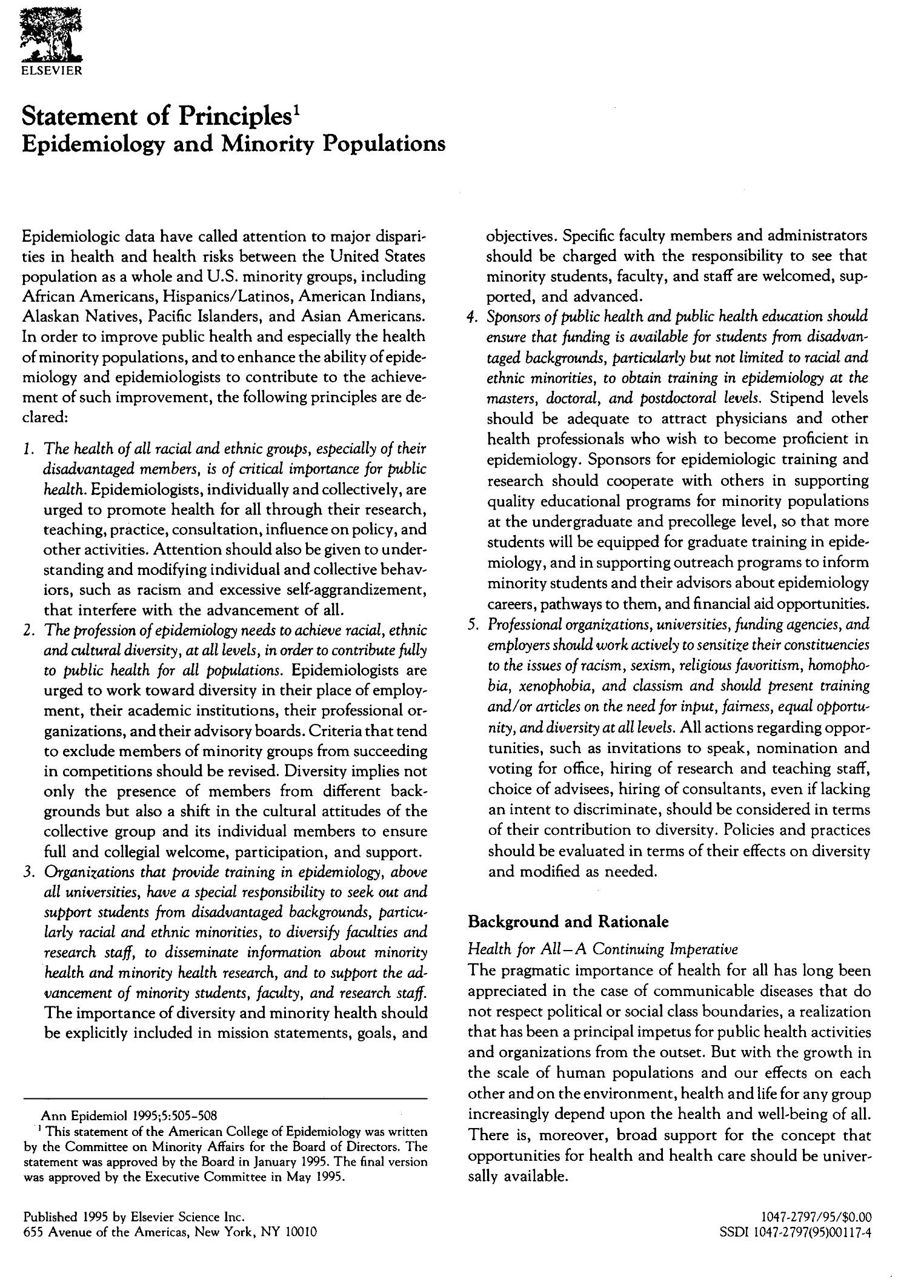
Notes:
At the September 1994 meeting the Board approved the proposed statement “in principle” and invited members to suggests. At its January 1995 meeting the Board approved the revised Statement “wholeheartedly” but requested a further comment period for editorial suggestions. These came principally from Board member and President=Elect Michael Bracken, who requested that the Statement be significantly shortened. Following these editorial changes the Board adopted the Statement at its May 1995 meeting and agreed to its publication in the College’s pages in the Annals of Epidemiology.
The final version begins with five declarations, followed by the background and rationale, and concludes with the actions to be taken by the College: The declarations are:
The health of all racial and ethnic groups, especially of their disadvantaged members, is of critical importance for public health.
The profession of epidemiology needs racial, ethnic and cultural diversity, at all levels, to contribute fully to public health for all populations.
[Educational organizations] . . . have a special responsibility to seek out and support students from disadvantaged backgrounds, particularly racial and ethnic minorities, to diversify faculties and research staff, and to disseminate information about minority health
Sponsors of public health and public health education should ensure that funding is available for students from disadvantaged backgrounds . . .
Organizations should work actively to sensitize their constituencies to the issues of racism, sexism, religious favoritism, homophobia, xenophobia, and classism and should present training and/or articles on the need for input, fairness, equal opportunity, and diversity at all levels.

Slide 41
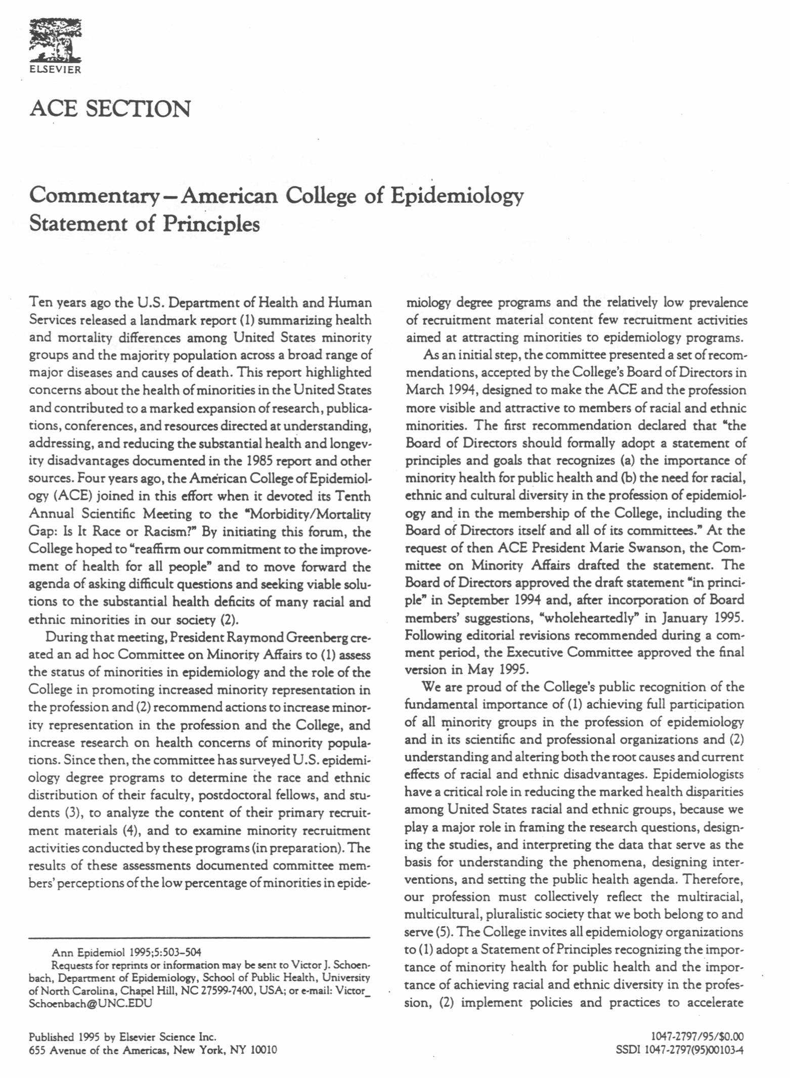
Notes:
The Statement of Principles, after revision and acceptance, appeared in the Annals of Epidemiology along with a commentary signed by seven ACE presidents and past presidents.

Slide 42
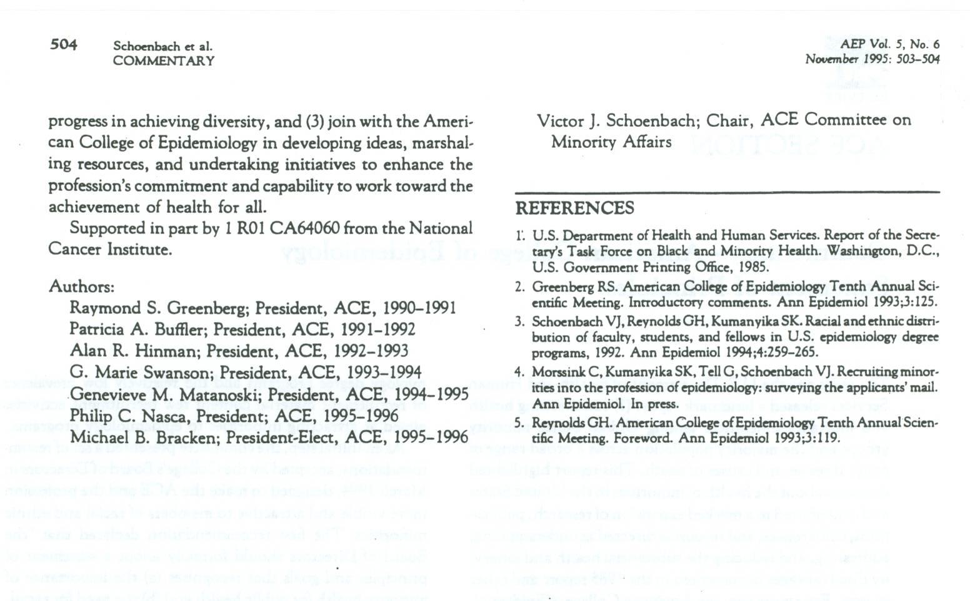
Signed by 7 ACE presidents

Slide 43
Outreach
“I've read the Statement, and I'm very impressed, both with it and the activities planned to implement it. It is remarkably consistent with a Statement on Discrimination in the Workplace, recently adopted by AAAS.”
Notes:
AAAS circulated the statement on various lists:
From: Gardenier, John S.
To: ALL-NCH07A/HYAT; ALL-NCH08A/HYAT; ALL-NCH09A/HYAT; ALL-NCH10A/HYAT;
All-NCH11A/HYAT
Subject: FW: FYI - work of the ACE Committee on Minority Affairs
Date: Friday, May 26, 1995 9:34AM
Priority: High
For those interested, the Committee on Minority Affairs of the American
College of Epidemiology has made recommendations to the Board of Directors
which are summarized below. This information was provided by the American
Association for the Advancement of Science. John G.
----------
Sender: AAAS Minority Perspectives on Ethics in Science and Technology
<AAASMSP@GWUVM.BITNET>
From: AFOWLER <afowler@AAAS.ORG>
Subject: FYI - work of the ACE Committee on Minority Affairs
X-To: aaasmsp@gwuvm.gwu.edu
To: Multiple recipients of list AAASMSP <AAASMSP@GWUVM.BITNET>
content-length: 6234
----------------------------------------------------------------------------
--
American College of Epidemiology
Committee on Minority Affairs
Policy Recommendations approved by the ACE Board of Directors
at their March 6, 1994 meeting

Slide 44
Outreach
“I have just been elected President-Elect of the Society for Pediatric Epidemiologic Research (SPER). My term as President will be from June 1996 to June 1997. I agree whole-heartedly with the ACE recommendations. One of my major concerns as SPER president will be affirmative action for the recruitment of minorities into reproductive, perinatal, and pediatric epidemiology.” John L. Kiely (5/26/1995 email)
Notes:
AAAS circulated the statement on various lists:
From: Gardenier, John S.
To: ALL-NCH07A/HYAT; ALL-NCH08A/HYAT; ALL-NCH09A/HYAT; ALL-NCH10A/HYAT;
All-NCH11A/HYAT
Subject: FW: FYI - work of the ACE Committee on Minority Affairs
Date: Friday, May 26, 1995 9:34AM
Priority: High
For those interested, the Committee on Minority Affairs of the American
College of Epidemiology has made recommendations to the Board of Directors
which are summarized below. This information was provided by the American
Association for the Advancement of Science. John G.
----------
Sender: AAAS Minority Perspectives on Ethics in Science and Technology
<AAASMSP@GWUVM.BITNET>
From: AFOWLER <afowler@AAAS.ORG>
Subject: FYI - work of the ACE Committee on Minority Affairs
X-To: aaasmsp@gwuvm.gwu.edu
To: Multiple recipients of list AAASMSP <AAASMSP@GWUVM.BITNET>
content-length: 6234
----------------------------------------------------------------------------
--
American College of Epidemiology
Committee on Minority Affairs
Policy Recommendations approved by the ACE Board of Directors
at their March 6, 1994 meeting

Slide 45
Outreach
“I read with interest the recommendation from ACE Committee on Minority Affairs. This is a huge important step foward. I would like to receive a copy of the Statement of Principles and also info on applying to the College.” Helene Gayle (6/28/1995 email)
Notes:
AAAS circulated the statement on various lists:
From: Gardenier, John S.
To: ALL-NCH07A/HYAT; ALL-NCH08A/HYAT; ALL-NCH09A/HYAT; ALL-NCH10A/HYAT;
All-NCH11A/HYAT
Subject: FW: FYI - work of the ACE Committee on Minority Affairs
Date: Friday, May 26, 1995 9:34AM
Priority: High
For those interested, the Committee on Minority Affairs of the American
College of Epidemiology has made recommendations to the Board of Directors
which are summarized below. This information was provided by the American
Association for the Advancement of Science. John G.
----------
Sender: AAAS Minority Perspectives on Ethics in Science and Technology
<AAASMSP@GWUVM.BITNET>
From: AFOWLER <afowler@AAAS.ORG>
Subject: FYI - work of the ACE Committee on Minority Affairs
X-To: aaasmsp@gwuvm.gwu.edu
To: Multiple recipients of list AAASMSP <AAASMSP@GWUVM.BITNET>
content-length: 6234
----------------------------------------------------------------------------
--
American College of Epidemiology
Committee on Minority Affairs
Policy Recommendations approved by the ACE Board of Directors
at their March 6, 1994 meeting

Slide 46
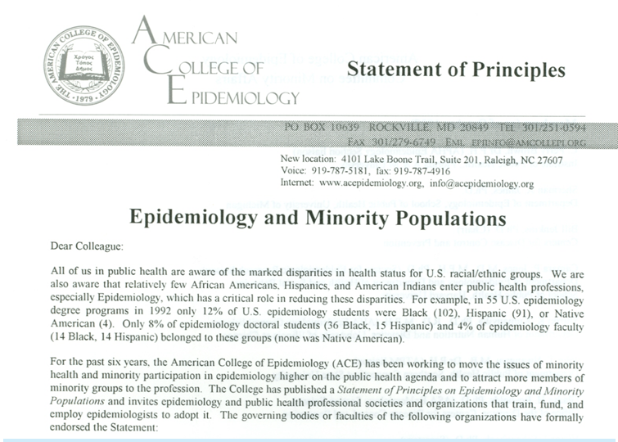
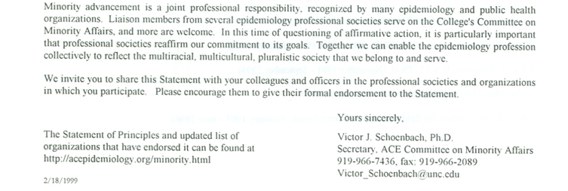
Notes:
The Statement was subsequently endorsed by over 20 epidemiology organizations and departments.

Slide 47
Endorsements from Professional Societies and Departments of Epidemiology
American College of Preventive Medicine
American Heart Association - Council on Epidemiology and Prevention
American Public Health Association
American Statistical Association - Section on Statistics in Epidemiology
Association of Schools of Public Health - Epidemiology Council
Association of Teachers of Preventive Medicine
Black Caucus of Health Workers
North American Association of Central Cancer Registries
Department of Biometry and Epidemiology, Medical University of South Carolina
Department of Biostatistics and Epidemiology, University of Massachusetts, Amherst
Department of Biostatistics and Epidemiology, University of Oklahoma Health Sciences Center
Department of Epidemiology and Preventive Medicine, School of Medicine, University of Maryland
Department of Epidemiology, School of Public Health, University of Michigan
Department of Epidemiology, School of Public Health, Harvard University
Department of Epidemiology, School of Public Health, University of California, Los Angeles
Department of Epidemiology, School of Public Health, UNC at Chapel Hill
Department of Epidemiology, School of Public Health and Community Medicine, University of Washington
Division of Chronic Disease Epidemiology, Epidemiology and Public Health, Yale University
Division of Epidemiology, Department of Health Research and Policy and Stanford Center for Research in Disease Prevention, Stanford University School of Medicine
Epidemiology Discipline, School of Public Health, University of Texas at Houston
Notes:
https://www.acepidemiology.org/ACE/PolicyStatements/Epidemiology_and_Minority_Populations__Statement_of_Principles.aspx

Slide 48
Study #2 - Content analysis of recruitment materials
Christiaan Morssink
Shiriki Kumanyika
Grethe Tell
Victor Schoenbach
Published in same issue of the Annals as the Statement of Principles (November 1995)

Slide 49
Content analysis of recruitment materials
“The question posed in this analysis was whether the mainstream recruitment materials distributed by institutions where epidemiology degrees are offered include text or illustrations to either stimulate or reinforce an interest among prospective minority applicants in studying epidemiology. In general, these materials did not address minority-related issues, especially not on the epidemiology department level.”
Notes:
“The question posed in this analysis was whether the mainstream recruitment materials distributed by institutions where epidemiology degrees are offered include text or illustrations to either stimulate or reinforce an interest among prospective minority applicants in studying epidemiology. In general, these materials did not address minority-related issues, especially not on the epidemiology department level.”

Slide 50
Committee on Minority Affairs – Plans, November 1995
Use the Statement of Principles to build commitment.
Recruit minority epidemiologists to the College.
Develop a statement on community participation in research
Recommend and facilitate ways to improve:
Notes:
ACE9509-Presentation.DOC

Slide 51
Committee on Minority Affairs – Plans - continued
a. Information, communications, networking
b. Outreach to colleges, medicine and veterinary medicine with large minority enrollments
c. Financial aid for minority students, fellows, and researchers
d. Education for the profession about minority health and diversity
e. Research related to minority health and minority advancement.

Slide 52
Study #3 - Survey of recruitment activities
Data collected for 1993-1994
Authors: Diane-Marie M. St. George
Victor J. Schoenbach
Gladys H. Reynolds (proposed the idea)
John Nwangwu
Lucile Adams-Campbell
Published: Annals of Epidemiology, 1997
About 2/3 of schools did outreach and about 1/6 departments

Slide 53
Committee chairs
Victor Schoenbach, 1991-1997
Bill Jenkins, 1997-1999
Vickie Mays, 1999-2005
Jorge Ibarra, 2005-2010
Charles Oke, 2010-2013
Maulik Baxi, 2013-2014
Bertha Hidalgo, 2014-
____ (your name here?)
Notes:
Updated 8/20/2017

Slide 54
Annual Minority Affairs Committee workshops
[Under Vickie Mays]
2002 Albuquerque
2003 Chicago
2004 Boston
2005 (New Orleans)
[Under Jorge Ibarra]
2006 Seattle
2007 Ft Lauderdale
2008 Tucson
2009 Silver Spring
2010 San Francisco
[Under Charles Oke]
2011 (Congress)
2012 Chicago
2013 Louisville
[Under Maulik Baxi and Bertha Hidalgo]
2014 Silver Spring
Notes:
2009 Silver Spring MD - “Achieving Diversity in the Field of Epidemiology: Progress Made,
Challenges and Opportunities”
2010 San Francisco - “Health Disparities: Definition, Measurements, Determinants, and Controversies”
2012 Chicago -
2013 Louisville – Systems dynamics

Slide 55
Annual Minority Affairs Committee workshops (cont’d)
[Under Bertha Hidalgo]
2015 Atlanta/Decatur
2016 Miami (Epid Congress)
2017 New Orleans
Notes:
2009 Silver Spring MD - “Achieving Diversity in the Field of Epidemiology: Progress Made,
Challenges and Opportunities”
2010 San Francisco - “Health Disparities: Definition, Measurements, Determinants, and Controversies”
2012 Chicago -
2013 Louisville – Systems dynamics

Slide 56
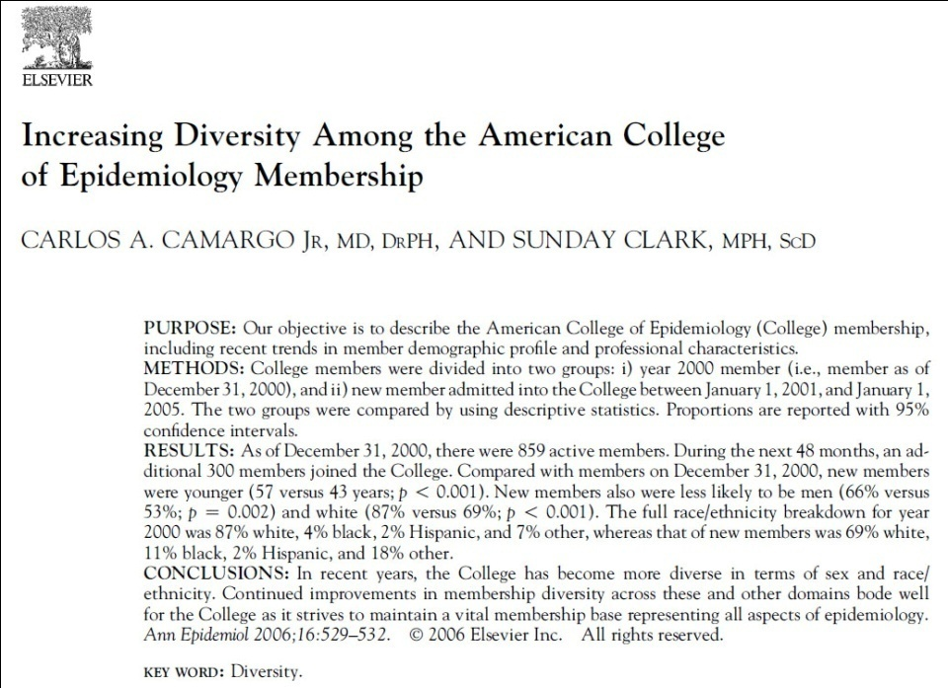
Annals of Epidemiology article by Camargo and Clark
859 active members of ACE as of 12/31/2000 compared to 300 new ACE members during 1/1/2001-12/31/2004:
Black: 4 + 11
Hispanic: 2 + 2
American Indian: 0+1
Asian: 6 + 16

Slide 57
2006 Congress of Epidemiology survey of participants
Annals of Epidemiology, April 2009
Olivia D. Carter-Pokras
Robert Spirtas
Lisa Bethune
Vickie Mays
Vincent L. Freeman
Yvette C. Cozier
7.4%, 7%, and 1.3% of attendees were Black, Latino, or AI/AN

Slide 58
ASPH data reports, graduates 2000-2001 vs 2008-2009
American Indian / Alaska Native
Biostatistics 1 > 0
Epidemiology 2 > 3
Environmental sciences 4 > 1
Black/African American
Biostatistics 12 > 17
Epidemiology 53 > 105
Environmental sciences 35 > 41
Hispanic / Latino
Biostatistics 10 > 9
Epidemiology 43 > 78
Environmental sciences 33 > 44
Notes:
Source: Association of Schools of Public Health, Annual Data Report for 2001 2001 and 2009
2001 report:
Table 4-6 Graduates by Program Area, Gender, Citizenship & Race/Ethnicity /1 (2000-2001)
2009 report:
Table 4.10 – Graduates by Program Area, Gender, and Citizenship (2008-2009)
Numbers from spreadsheet – verify #’s

Slide 59
The conversation has changed
Health disparities are now high on the agenda.
Diversity and inclusion are regarded as necessary and important.
Diversity includes sexual/gender identity, disability/special needs, and religious minorities.
Underrepresentation is acknowledged to be a problem, but solutions remain elusive.
Have the political tides shifted?

Slide 60
Measurement challenges
“Underrepresentation” – how to define and measure? Who qualifies?
What is the appropriate denominator – total population? U.S.? Age-matched population? High-school graduates? College graduates? Science majors?
What about factors that have constrained the denominators?

Slide 61
A few ideas for the future
Connections and collaborations with other societies (e.g., SER, APHA) and organizations (e.g., HDEART)
Grant proposals (e.g., Victor Cardenas and Jorge Ibarra)
Give an annual award in the name of a committee founder, chair, or supporter (e.g., Ray Greenberg, Gladys Reynolds, Bill Jenkins, John Nwangwu, Sherman James, Vickie Mays, Victor Cardenas, Jorge Ibarra, Charles Oke, Bertha Hidalgo, …)
Notes:
Epidemiologic research on David Lynch Foundation program impacts

Slide 62
Thank you!
Victor J. Schoenbach
vjs@unc.edu
http://go.unc.edu/vjs
Visit the “Virtual Library” at http://go.unc.edu/sjae
Or Google
minority affairs committee site:sakai.unc.edu

