Slide 1
Why haven’t compelling epidemiologic data eliminated health disparities?
Presented at the American College of Epidemiology Minority Affairs Committee Workshop
September 23, 2017, New Orleans LA
Victor J. Schoenbach, Ph.D., http://go.unc.edu/vjs
Department of Epidemiology and Minority Health Project
UNC Gillings School of Global Public Health
Notes:
Last updated 9/23/2017, 1/14/2019

Slide 2
Outline
Public health achievements are dramatic but not universally shared.
Efforts to reduce or eliminate disparities extend over many decades.
Is there an epidemiology of public health?
New possibilities

Slide 3
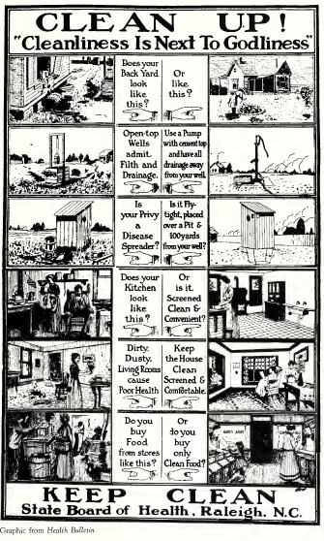
I. Public health achievements are dramatic but not universally shared

Slide 4
Ten Great Public Health Achievements -- United States, 1900-1999
Vaccination
Motor-vehicle safety
Safer workplaces
Control of infectious diseases
Decline in deaths from coronary heart disease and stroke
Safer and healthier foods
Healthier mothers and babies
Family planning
Fluoridation of drinking water
Recognition of tobacco use as a health hazard
https://www.cdc.gov/mmwr/preview/mmwrhtml/00056796.htm

Slide 5
One achievement: Decline in infant mortality, 1915-2010*
*Note: For years 1915-1960, “White” included persons stated to be “White,” “Cuban,” “Mexican,” or “Puerto Rican.” All others during that time period were referred to as “Nonwhite.”
Figure courtesy of Bill Jenkins.
Notes:
From Bill Jenkins

Slide 6
Black-White Ratio of Infant Mortality, United States: 1915-2010*
YEAR
*Note: For years 1915-1960, “White” included persons stated to be “White,” “Cuban,” “Mexican,” or “Puerto Rican.” All others during that time period were referred to as “Nonwhite.”
Figure courtesy of Bill Jenkins
Notes:
From Bill Jenkins

Slide 7
Age Adjusted Death Rate Ratios
 | 1950 | 1960 | 1970 | 1980 | 1990 | 2000 | 2002
Heart Dis | 1.0 | 1.0 | 1.1 | 1.1 | 1.2 | 1.3 | 1.3
Stroke | 1.3 | 1.4 | 1.4 | 1.4 | 1.5 | 1.4 | 1.4
Cancer | 0.9 | 1.0 | 1.1 | 1.3 | 1.3 | 2.6 | 1.2
Diabetes | 1.0 | 1.2 | 1.2 | 2.0 | 2.2 | 2.2 | 2.1
HIV | --- | --- | --- | --- | 3.2 | 8.3 | 8.6
Homocide | 10.9 | 9.6 | 9.4 | 5.8 | 6.6 | 5.7 | 5.6
Slide courtesy of Bill Jenkins
Notes:
From Bill Jenkins

Slide 8
AIDS by Ethnicity: United States, 1990-2000
Slide courtesy of Bill Jenkins
Notes:
From Bill Jenkins

Slide 9
II. Efforts to reduce or eliminate disparities extend over many decades

Slide 10
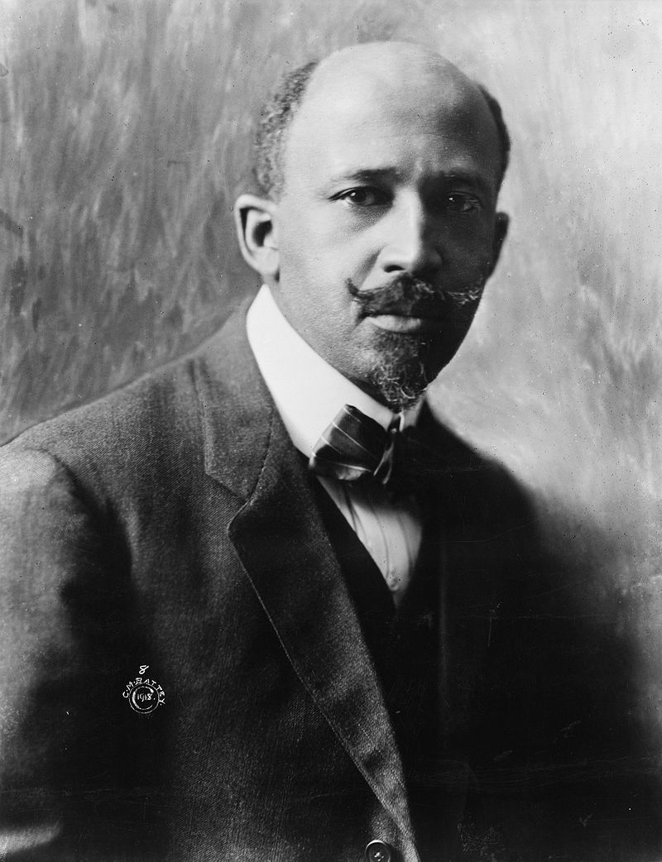
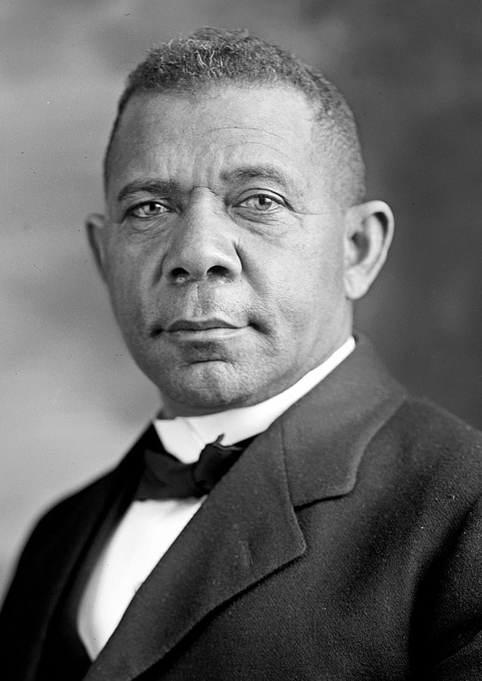
W.E.B. Du Bois, Booker T. Washington
Left: W. E. B. Du Bois (1868 – 1963), in 1918. by Cornelius Marion (C.M.) Battey (1873–1927)
Photo source: https://en.wikipedia.org/wiki/W._E._B._Du_Bois#/media/File:WEB_DuBois_1918.jpg
Right: Booker T. Washington, by Harris & Ewing, 1905. Photo source: https://commons.wikimedia.org/wiki/File:Booker_T_Washington_retouched_flattened-crop.jpg

Slide 11
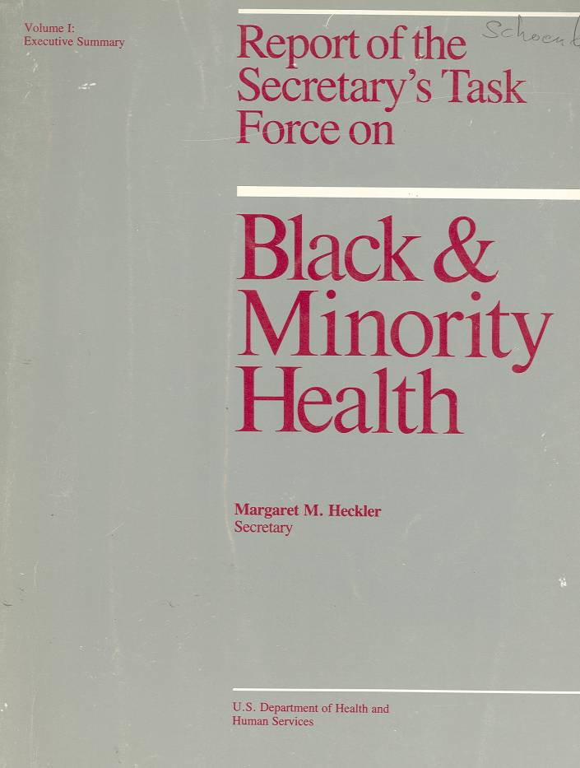
The Heckler Report
The Task Force was led by Dr. Thomas Malone, Deputy Director of the National Institutes of Health, and Dr. Katrina Johnson.
Notes:
Perspectives in Disease Prevention and Health Promotion Report of the Secretary's Task Force on Black and Minority Health
MMWR February 28, 1986 / 35(8);109-12
http://www.cdc.gov/mmwr/preview/mmwrhtml/00000688.htm
http://www.nytimes.com/1985/10/17/us/minorities-seen-as-still-lagging-in-health-status.html?mcubz=3
The Task Force made eight main recommendations to the Secretary, each of which was followed by several specific suggestions:
1. Implement an outreach campaign, specifically designed for minority populations, to disseminate targeted health information, educational materials, and program strategies.
2. Increase patient education by developing materials and programs responsive to minority needs and by improving provider awareness of minority cultural and language needs.
3. Improve the access, delivery, and financing of health services to minority populations through increased efficiency and acceptability.
4. Develop strategies to improve the availability and accessibility of health professionals to minority communities through communication and coordination with nonfederal entities.
5. Promote and improve communication and coordination among federal agencies in administering existing programs for improving the health status and availability of health professionals to minorities.
6.Provide technical assistance and encourage efforts by local and community agencies to meet minority-health needs.
7.Improve the quality, availability, and use of health data pertaining to minority populations.
8. Adopt and support research to investigate factors affecting minority health, including risk-factor identification, education interventions, and prevention and treatment services.

Slide 12
1985 Report of the Secretary’s Task Force
"Despite the unprecedented explosion in scientific knowledge and the phenomenal capacity of medicine to diagnose, treat, and cure disease, Blacks, Hispanics, Native Americans, and those of Asian/Pacific Islander heritage have not benefited fully or equitably from the fruits of science or from those systems responsible for translating and using health sciences technology.“ (Introduction and Overview)
Notes:
It was noted by many at the time that the health disadvantages of American minorities was not a new discovery. W.E.B. DuBois, for example, had written about these at the turn of the century. Some 15 year’s earlier the Kerner Commission on Civil Disorders had described the racial dualism pervading American society, echoing the observations made by Swedish economist Gunnar Myrdal in An American Dilemma. 1985 was only two decades after African Americans had endured mass arrests, cattle prods, arson, bombings, assassinations, and other legal and extra-legal actions carried out to enforce disparities in employment opportunity, housing, public accommodations, health care access and other areas. But even if the health disparities documented by the Heckler Report were neither new nor unexpected, the Report nevertheless did drew considerable attention and served as a touchstone for putting health disparities on the national agenda.

Slide 13
National Black Leadership Initiative on Cancer
Per Lovell Jones, 9/17/2017: Dr. Louis Sullivan was on the National Cancer Advisory Board (NCAB) and pushed the National Cancer Institute (NCI) to do something in response to the Heckler report. NCAB agreed to hold six regional fact-finding meetings/summits under the name National Black Leadership Initiative on Cancer (NBLIC). Sullivan recruited Morehouse alumni and National Medical Association (NMA) members in six cities: Los Angeles and Atlanta - Dr. M. Alfred Haynes; Chicago - Dr. Clyde Phillips; New York - Dr. Harold Freeman; Washington, D.C. - Dr. LaSalle D. Leffall, Jr.; and Houston - Dr. Dezra White, joined by Lovell Jones.
In fall 1988, after the six meetings/summits, the group met with Dr. Alan Rabson, then Interim Director of the National Cancer Institute (NCI). When he basically offered nothing, Clyde Phillips said, "I can't leave your office and go back to Chicago with nothing. All of us agreed that we couldn't go back without some formal commitment. Essentially they had a sit-in.
The end result was supplemental funds to the Drew-Meharry-Morehouse Consortium Cancer Center to create six NBLIC Regions to address community cancer prevention and control needs from 1989-1992.
Notes:
Origins of the National Black Leadership Initiative on Cancer, recounted by Lovell Jones (with some editing and elaboration by Vic Schoenbach), September 17, 2017:
In 1985, the Report of the Secretary’s Task Force on Black & Minority Health (the “Heckler Report”) was released. The report was written by a 19-member study group headed by NIH Deputy Director Thomas Malone. Dr. Louis Sullivan was on the National Cancer Advisory Board (NCAB) and was pushing the National Cancer Institute (NCI) to do something in response to the report. At the same time, I was beginning the groundwork to launch the Biennial Symposium on Minorities, which became the Biennial Symposium on Minorities, the Medically Underserved and Cancer.
NCAB agreed to hold six regional fact-finding meetings/summits under the name of the National Black Leadership Initiative on Cancer (NBLIC). To launch the initiative, Dr. Sullivan tapped Morehouse alumni and National Medical Association (NMA) members in six cities: Los Angeles and Atlanta - Dr. M. Alfred Haynes; Chicago - Dr. Clyde Phillips; New York - Dr. Harold Freeman; Washington, D.C. - Dr. LaSalle D. Leffall, Jr.; and Houston - Dr. Dezra White. Because Dr. White was not at an academic institution and because of my role in creating the Biennial Symposium, Dr. White approached mel to co-chair the Houston summit and to do so under the banner of MD Anderson.
Involvement of MD Anderson conveyed a certain status to the meetings/summits. After the six meetings/summits, the group of us met with Dr. Alan Rabson, then Interim Director of the National Cancer Institute (NCI) in fall 1988. We gave him the report and asked what would be the next steps. When he basically said nothing, I remember Clyde Phillips saying, "I can't leave your office and go back to Chicago with nothing. That triggered a sit-in. All of us agreed that we couldn't go back without some formal commitment.
The end result was supplemental funds to the Drew-Meharry-Morehouse Consortium Cancer Center to create six NBLIC Regions to address community cancer prevention and control needs from 1989-1992.

Slide 14
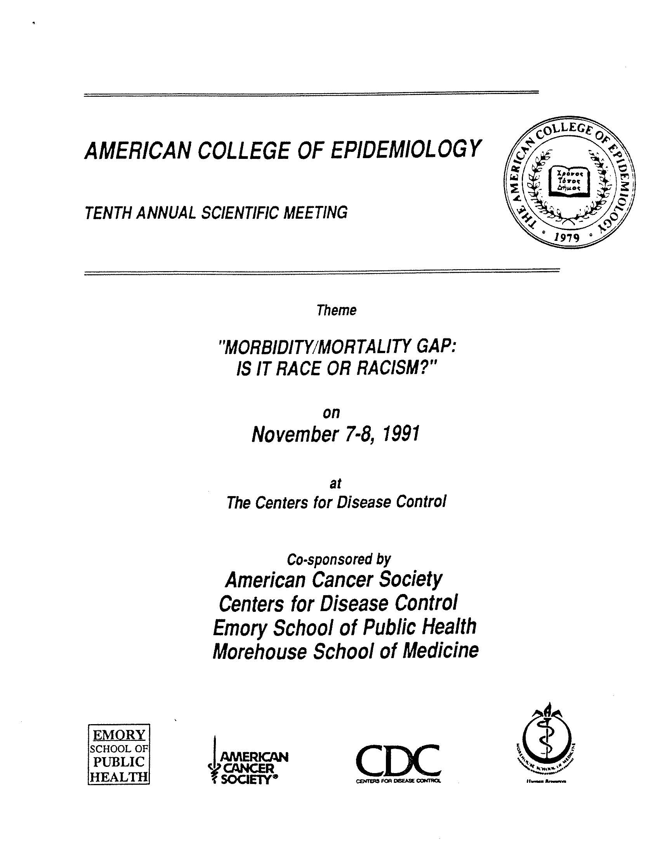
ACE 10th Annual Scientific Meeting, 1991 in Atlanta, GA
Morbidity/Mortality Gap:
Is it Race or Racism?”
Notes:
For members of the American College of Epidemiology, the next landmark is the 10th Annual Scientific Meeting, held at CDC in Atlanta in 1991
For many of us, the program was a consciousness-raising experience.
CDC notice of November 7-8, 1991meeting: http://www.cdc.gov/mmwr/preview/mmwrhtml/00001973.htm

Slide 15
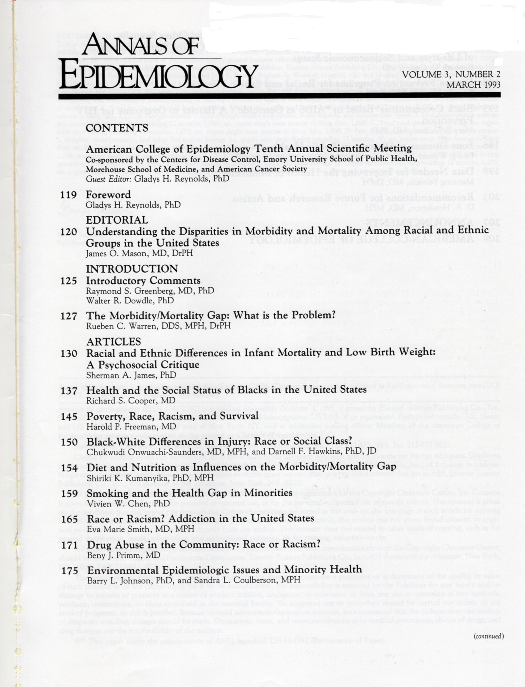
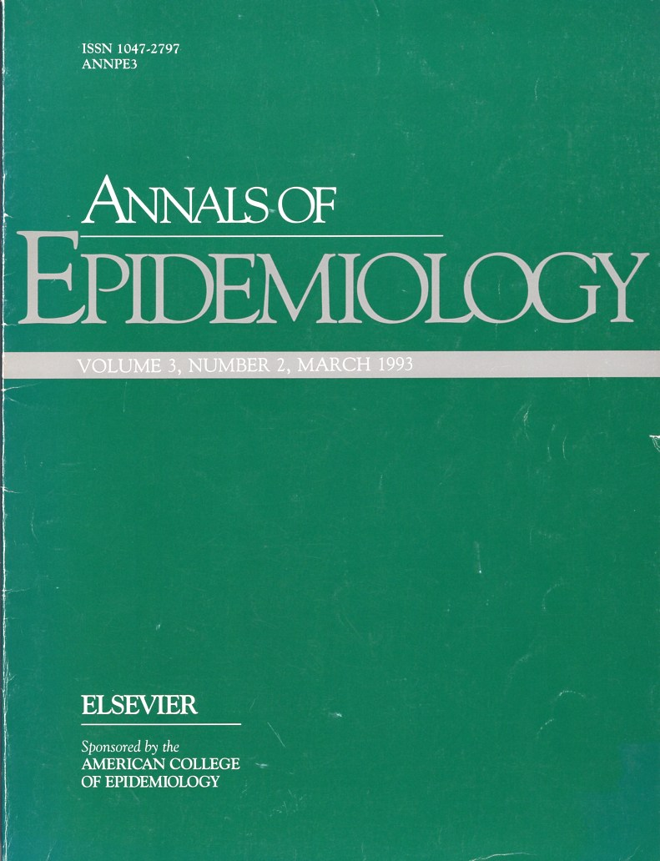
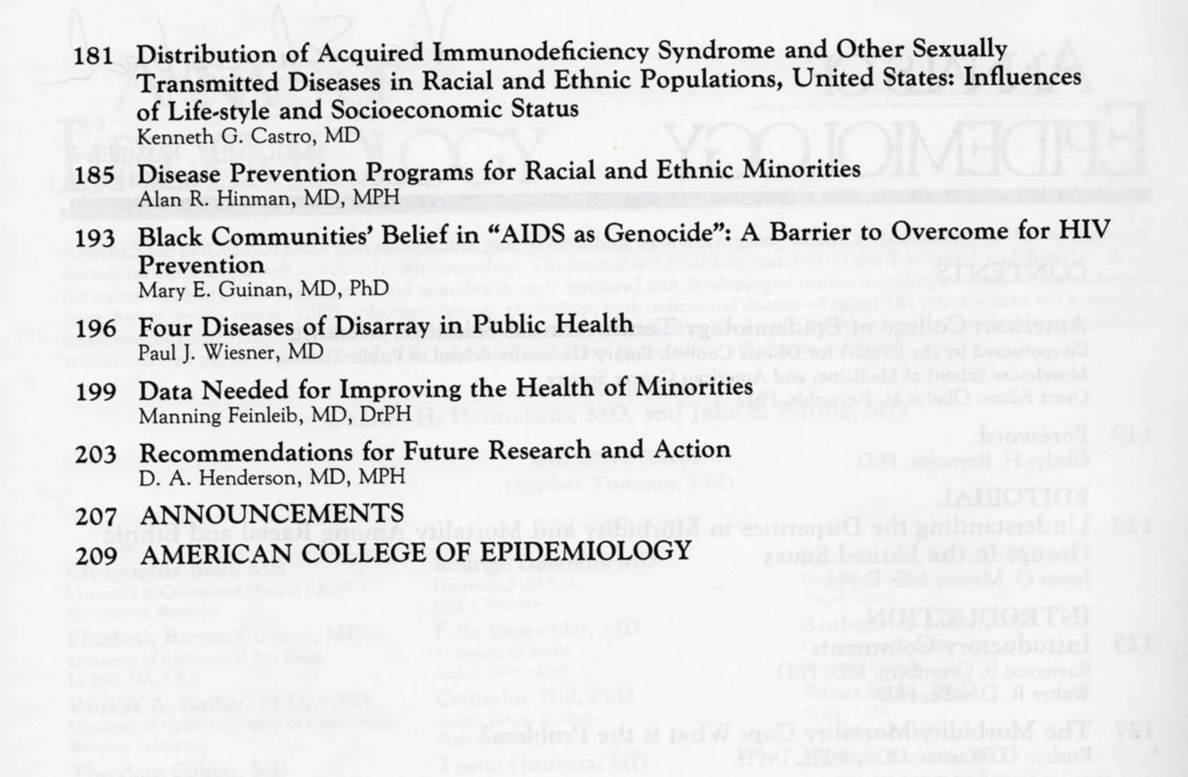
Notes:
The invited presentations were published together in a 1993 issue of the Annals of Epidemiology guest edited by Gladys Reynolds. Unlike most other ACE annual meetings, the 1991 meeting also had contributed papers. Many of these were published in Ethnicity & Disease, Spring, 1993 (Vol.3, No 2). Richard S. Cooper, one of the invited speakers was editor of Ethnicity & Disease. (Per Gladys Reynolds)

Slide 16
Foreward, by Gladys H. Reynolds, PhD
“We need to ask why these differences exist. We need to be concerned about the data we lack and the quality of the data we do have. We need to reanalyze and reinterpret the data in order to understand the relationship between these disparities and past and current racial discrimination in education, access to jobs, housing and health care, and political power…. Most importantly, we need to develop prevention and intervention strategies appropriately designed for different cultures…. People of different races, ethnic groups, genders, and backgrounds can and should be given active roles in defining themselves and in making the decisions that determine how much and to which groups, and to which health area or disease, resources are allocated.“
Annals of Epidemiology March 1993;3(2):119
Notes:
Many of the presentations were published together in a 1993 issue of the Annals of Epidemiology guest edited by Gladys Reynolds.

Slide 17
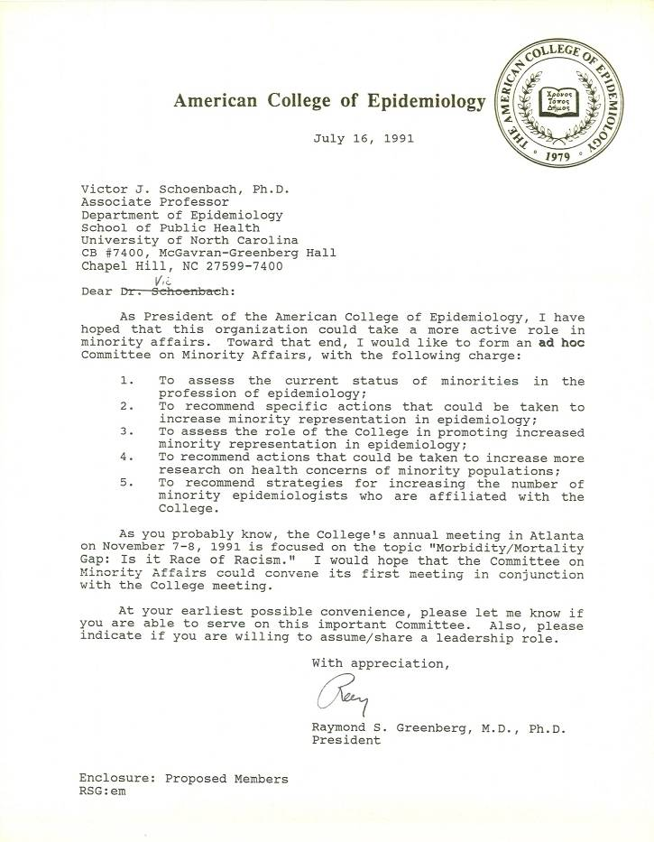
ACE President forms ad hoc Committee on Minority Affairs
“As President of the American College of Epidemiology, I have hoped that this organization could take a more active role in minority affairs.”
Raymond S. Greenberg, MD, PhD
Notes:
In 1991, the ACE was still trying to define its role in the profession. One of the basic motivations for creating the College, credentialing of non-physician epidemiologists, was being rethought. Few people had taken the credentialing examination, and the value of the credential was uncertain. But without the certification exam, what was the College’s raison-d’etre? At the same time, the College was the only epidemiology organization whose primary focus was serving the needs of practicing epidemiologists and at the time the only one willing and able to take official policy positions. The major initial policy thrust was about professional ethics. President Raymond Greenberg and others felt that racial disparities in health would be another policy area for which the organization might take leadership, and through which it could engage members who were not particularly motivated by the ethics issue.
So with enthusiastic support from the Board of Directors, President Greenberg created an ad hoc Committee on Minority Affairs. He put out a call to members seeking volunteers. I was one of those who responded, and Ray asked if I would serve as chair and convene an initial meeting in conjunction with the 1991 Annual Scientific Meeting. I objected, saying that someone like Sherman James should probably be chair. But when I asked Sherman, he said that I should be chair since I would follow his advice and he wouldn’t have to devote as much time! On that basis I agreed.

Slide 18
Recommendations
Epidemiology’s mission should include advancement of minority health / minority epidemiologists.
Study minority health problems and solutions; study racism.
Conduct vigorous outreach to make epidemiology careers and financial aid opportunities more visible to minorities.
Provide ample, stable funding for minority training and supportive educational environments, plus networks of minority epidemiologists.
Federal programs (e.g., MARC, MBRS, HCOP) should expand their coverage of epidemiology research and training; more programs should be created like the CDC's Project IMHOTEP.
Professional development opportunities should include diversity training related to the review of applications for admission, applications for grants, submitted manuscripts, etc.
A body analogous to the AAMC Division of Minority Health, Education, and Prevention should be provided a mandate and resources to monitor progress in increasing the role of underrepresented minorities in epidemiology. Recognize/support/reward epidemiologists who make exceptional contributions.
Notes:
Recommendations:
1. The mission of epidemiology organizations should include advancement of minority health and of minority epidemiologists and trainees in professional, educational, corporate, and governmental settings. Institutional commitment should be expressed in the leadership provided by deans, directors, and chairs, in effective actions, in provision of resources, and in increased diversity.
2. Greater attention should be given in epidemiology journals and scientific meetings to studies that address minority health problems with insight and cultural sensitivity, and especially, that identify potential solutions to these problems. Epidemiology forums should also invite studies on the nature of, effects of, and interventions to reduce racism, both individual and institutional (8,9).
3. A vigorous outreach campaign is needed to make epidemiology careers, pathways to them, and financial aid opportunities more visible in minority educational institutions and minority communities. The potential of minority recruitment activities is illustrated by a program at the CDC EIS, where minority representation among trainees rose from 11 percent in the 1980's to 17 percent in the 1990 EIS class and 26 percent in the 1991 class (23).

Slide 19
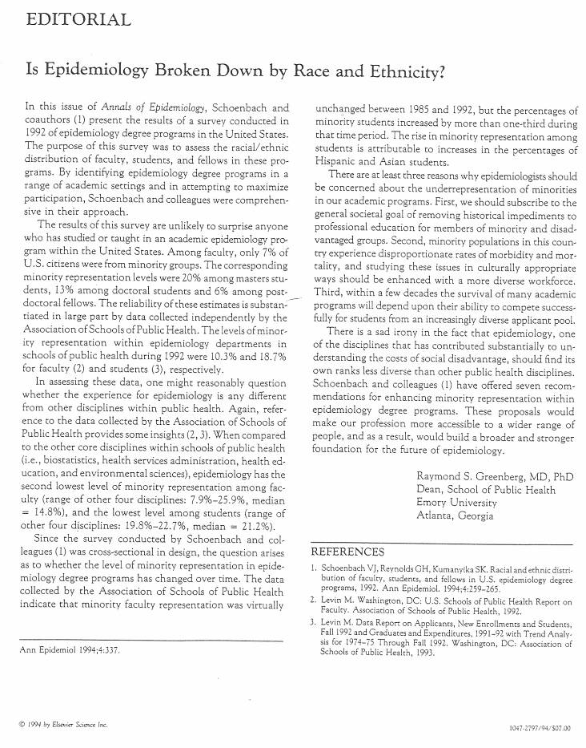
Annals of Epidemiology editorial by Ray Greenberg
“These proposals would make our profession more accessible to a wider range of people, and as a result, would build a broader and stronger foundation for the future of epidemiology.”

Slide 20



Healthy People – Overarching goals
Healthy People 2010:
Goal 1: Increase Quality and Years of Healthy Life
Goal 2: Eliminate Health Disparities
Healthy People 2020:
Attain high quality, longer lives free of preventable disease, disability, injury, and premature death.
Achieve health equity and eliminate disparities.
Create social and physical environments that promote good health for all.
Promote quality of life, healthy development, and healthy behaviors across all life stages.
Notes:
“Healthy People 2010 is designed to achieve two overarching goals:
Goal 1: Increase Quality and Years of Healthy Life
The first goal of Healthy People 2010 is to help individuals of all ages increase life expectancy and improve their quality of life.
Goal 2: Eliminate Health Disparities
The second goal of Healthy People 2010 is to eliminate health disparities among different segments of the population.”
http://www.healthypeople.gov/2010/About/goals.htm

Slide 21




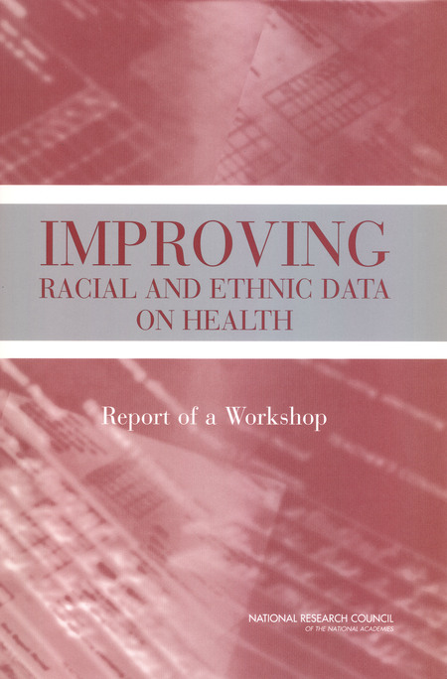



National Academy Press
Notes:
A sampling from the first 200 “hits” for a search for “health disparities”
https://www.nap.edu/catalog/10186/the-right-thing-to-do-the-smart-thing-to-do
https://www.nap.edu/catalog/10512/guidance-for-the-national-healthcare-disparities-report
https://www.nap.edu/catalog/10833/improving-racial-and-ethnic-data-on-health-report-of-a
https://www.nap.edu/catalog/9939/promoting-health-intervention-strategies-from-social-and-behavioral-research
https://www.nap.edu/catalog/6034/toward-environmental-justice-research-education-and-health-policy-needs
https://www.nap.edu/catalog/6259/leading-health-indicators-for-healthy-people-2010-first-interim-report
https://www.nap.edu/catalog/23541/advancing-the-science-to-improve-population-health-proceedings-of-a
https://www.nap.edu/catalog/24824/lessons-learned-from-diverse-efforts-to-change-social-norms-and-opportunities-and-strategies-to-promote-behavior-change-in-behavioral-health
https://www.nap.edu/catalog/10885/in-the-nations-compelling-interest-ensuring-diversity-in-the-health
https://www.nap.edu/catalog/11329/assessment-of-nih-minority-research-and-training-programs-phase-3
https://www.nap.edu/catalog/10979/eliminating-health-disparities-measurement-and-data-needs
https://www.nap.edu/catalog/13383/how-far-have-we-come-in-reducing-health-disparities-progress
https://www.nap.edu/catalog/12154/challenges-and-successes-in-reducing-health-disparities-workshop-summary
https://www.nap.edu/catalog/11602/examining-the-health-disparities-research-plan-of-the-national-institutes-of-health
https://www.nap.edu/catalog/10260/unequal-treatment-confronting-racial-and-ethnic-disparities-in-health-care
https://www.nap.edu/catalog/24624/communities-in-action-pathways-to-health-equity

Slide 22
Legislation, strategic plans, organizations, grants, …
Private organizations adopt strategic plans, etc.
Various federal and state agencies create offices of minority health; all NIH institutes formulate strategic plans.
NIH ORMH > NCMHD > NIMHD
“In fiscal year 2001, the NIH spent over $2 billion on research, research infrastructure, and public information and community outreach efforts to reduce health disparities. This provided a strong basis for further investments over the longer term – investments that promise substantial progress in reducing the incidence, prevalence, severity, and social and economic burdens of diseases and disabilities that affect racial and ethnic minorities and other health disparity populations.”
Notes:
Source for quote: NIH Strategic Research Plan and Budget to Reduce and Ultimately Eliminate Health Disparities: Foreward. (see TranslatingEpidIntoActionOnDisparities-201209.ppt

Slide 23
But counterveiling forces
War on Drugs
War on Crime
Our “Carceral Society”
Private, for-profit prisons
Technology and automation
Globalization – outsourcing of jobs, immigration of low skilled workers
Genomics and biotechnology
Escalation in educational requirements vs. de-escalation in funding for public education = student debt
. . .

Slide 24


National Academy Press
Notes:
Selected from the first 200 “hits” for a search for “health disparities”

Slide 25
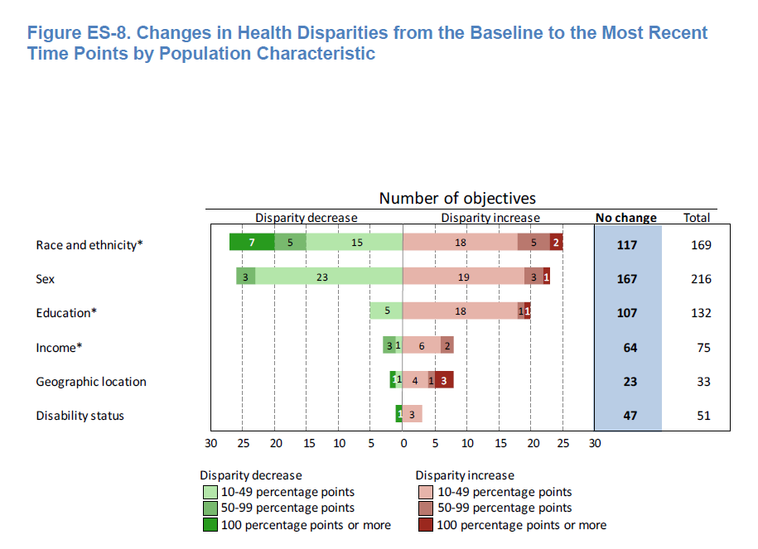
Healthy People 2010 Final Review: Changes in health disparities
(Healthy People 2010 Final Review)
“most of the population-based objectives with data to measure disparities had no change in health disparities.”
Notes:
Healthy People 2010 Final Review
Executive Summary Page ES-26
Figure ES-8. Changes in Health Disparities from the Baseline to the Most Recent Time Points by Population Characteristic
NOTES: Changes in disparity from the baseline to the most recent time points are only shown when they could be assessed. Changes could not be assessed for 54, 82, 4, 3, 10, and 17 objectives by race/ethnicity, sex, education, income, geographic location, and disability status, respectively. “No change” includes: changes of less than 10 percentage points, regardless of statistical significance; and all changes that were not statistically significant, when estimates of variability were available. See Technical Appendix.
* Number of objectives with changes in the summary index as a measure of disparity. Health disparities by income were not included for Focus Area 19 due to data limitations.
http://www.cdc.gov/nchs/data/hpdata2010/hp2010_final_review_executive_summary.pdf
See also Technical Appendix: http://www.cdc.gov/nchs/data/hpdata2010/hp2010_final_review_technical_appendix.pdf

Slide 26
ASPPH – 32 years after Heckler
Despite great strides in the advancement of public health, health disparities – based on ethnicity, race, or socioeconomic class – still exist, leading to populations that are disproportionately affected by disease and have limited access to health care. Disadvantaged populations often find affordable health care to be inaccessible, and more prominent incidences of chronic diseases, like obesity and heart disease, are common. Professionals in the public health field are committed to making health care accessible to all sectors of society and discovering how to serve diverse individuals and populations, which may be at greater risk.
http://www.aspph.org/discover/#addressing-health-disparities
Notes:
Selected from the first 200 “hits” for a search for “health disparities”

Slide 27
Hookworm in Lowndes County, AL
“The parasite, better known as hookworm, enters the body through the skin, usually through the soles of bare feet, and travels around the body until it attaches itself to the small intestine where it proceeds to suck the blood of its host. Over months or years it causes iron deficiency and anemia, weight loss, tiredness and impaired mental function, especially in children, helping to trap them into the poverty in which the disease flourishes.
“Hookworm was rampant in the deep south of the US in the earlier 20th century, sapping the energy and educational achievements of both white and black kids and helping to create the stereotype of the lazy and lethargic southern redneck. As public health improved, most experts assumed it had disappeared altogether by the 1980s.”
Quoted from Ed Pilkington, “Hookworm, a disease of extreme poverty, is thriving in the US south. Why?”, The Guardian, Sept 5, 2017
https://www.theguardian.com/us-news/2017/sep/05/hookworm-lowndes-county-alabama-water-waste-treatment-poverty
Based on “Human Intestinal Parasite Burden and Poor Sanitation in Rural Alabama”, Megan L. McKenna et al. American Journal of Tropical Medicine and Hygiene, 05 Sept 2017; https://doi.org/10.4269/ajtmh.17-0396

Slide 28
III. Is there an epidemiology of public health?

Slide 29
Why would compelling epidemiologic data lead to the elimination of health disparities?
Have compelling epidemiologic data led to the elimination of tobacco? Hospital-acquired infections? Antibiotic resistance? Widespread handgun ownership? Climate change?
There are many competing desires and priorities for individual and collective action. People do what they have to do – but they may resent that; what they think they ought to do – but they may resent that also; what they want to do – but they may regret that; or they just do whatever!

Slide 30
Social determinants of health – epidemiology as a population science: examples
Leonard Syme ─ Historical perspective
Nancy Krieger – Epidemiology and the web of causation: Has any one seen the spider? and Epidemiology and the People’s Health. Theory and Context
Anthony McMichael ─ Globalization, Climate Change, and Human Health
Carl Shy – The failure of academic epidemiology: Witness for the prosecution
David Williams ─ Social and Behavioral Determinants of Toxic Stress
David Satcher ─ Social Determinants of Health and Their
Implications for Public Health
Moyses Szklo – Epidemiology for public health: Are we missing the boat?
Sandro Galea – The social in context: On rational directions in quantitative population health science
Sir Michael Marmot ─ Social Determinants of Health

Slide 31
Epidemiology, Equity, Economics, Evolution, and Enlightenment
Victor J. Schoenbach, http://go.unc.edu/vjs
August 24, 2016
Social Epidemiology Seminar
UNC Department of Epidemiology
(audio recording available at https://sakai.unc.edu/x/Cc8ln3)

Slide 32
Epidemiology, Equity, Economics, Evolution, and Enlightenment
Epidemiology – for understanding and improving health of all people
Equity – equity / social justice reflects the distribution of power
Economics – economic resources are fundamental to public health, and their distribution depends on social forces
Evolution – fundamentally, we and our societies are expressions of biology, evolving through time as an emergent phenomenon
Enlightenment – broader and deeper understanding of our nature and our environment may help humanity manage our collective lives better, advancing public health in the present and future
From Social Epidemiology Seminar, UNC Dept of Epidemiology, Aug. 24, 2016
(See notes page for links to slides and audio.)
Notes:
Slides: https://sakai.unc.edu/access/content/user/vschoenb/Public%20Library/People/People/Victor%20Schoenbach/Presentations/SocialEPIDseminar20160824live.pptx
Audio (40 minutes):
https://sakai.unc.edu/access/content/user/vschoenb/Public%20Library/People/People/Victor%20Schoenbach/Presentations/SocialEPIDseminar-20160824noQuestions.mp3

Slide 33
We are systems within systems
Complexity: Life is an “emergent phenomenon” that arises from the actions of innumerable agents – organizations, individuals, neurons, macromolecules, etc. (Examples of emergent phenomena are at http://www.evolutionofcomputing.org/Multicellular/Emergence.html ).

Slide 34
We have evolved to cope with complexity
In attempting to cope with the complexity of life, we (humans and other animals that employ reasoning) create simplified representations for our perceptions, reasoning, and understanding, and simplified maxims to live by (“significant results”, “evidence-based”, “treat thy neighbor as one would be treated”, etc.). Such reductionism has been extremely effective in successfully navigating the challenges of living and interacting, enabling species to flourish – and also occasioning major problems where important elements of a situation are overlooked.

Slide 35
But that entails being selective, simplifying, and probably oversimplifying
Simplifications – models – are evaluated and declared useful, effective, accurate, etc., based on what we regard as important though inevitably incomplete criteria. For obvious practical reasons, the criteria must be observable (“measurable objectives”), relatively near-term, not too subtle, and “relevant” to what we regard as important. For example, we will declare a teaching innovation to be effective if it appears to improve student performance on examinations. If it also hastens the onset of dementia by two decades, we cannot know that.

Slide 36
Science is also a system within systems
Scientific research is a broad conversation in which different investigator communities explore, present, critique, debate, persuade (or not) others until some kind of consensus is reached, possibly to be upset when a new discovery is accepted. The process of science involves persuading peers and gatekeepers that one has an idea worth pursuing (and being funded), publishable (because editors and reviewers think it’s worthy), and accurate (because serious criticisms do not arise). How else could the search for truth work? There are no available authorities except humans. Some regard God as the ultimate authority, but in any case humans are the channels for God's communications and enforcement.

Slide 37
Right choices are elusive
In addition, most actions have multiple effects - some “good” and others “bad”, some in the present and others only later on, some local and others distant. Because of diversity, a given phenomenon affects different people differently – “one size fits all” never completely applies. So actions affect some individuals and groups in one way and other individuals and groups in other ways. Thus, most important policy questions do not have “right” answers, but rather answers that are “right” for some and “wrong” for others (e.g., should we tax gasoline to bring its price back to $3/gallon?). There must always be trade-offs, typically without knowing the full accounting, and not on an abstract scale but in relation to different people's interests.

Slide 38
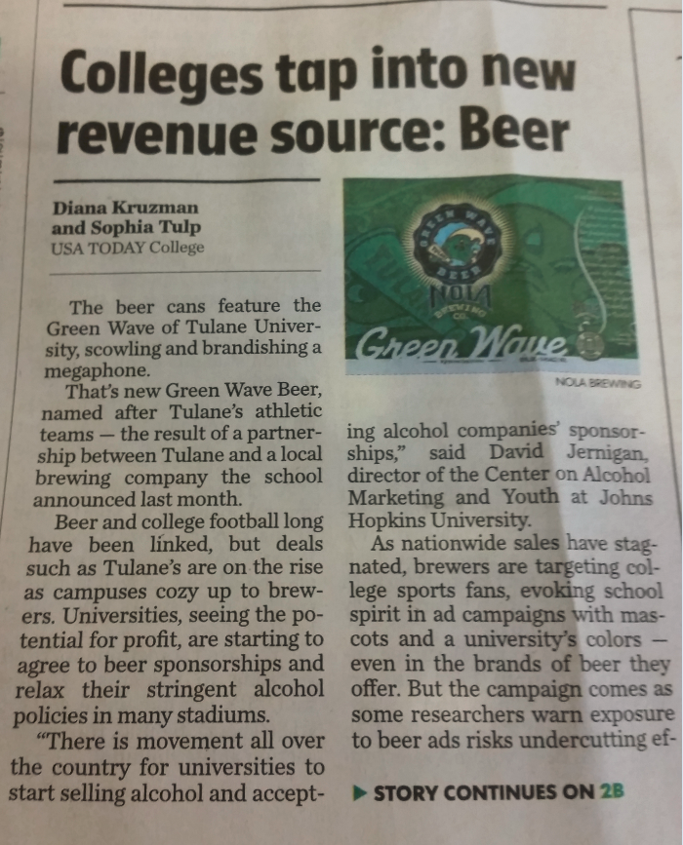
But people see things their own way, anyway
In a sense, it doesn’t matter that there may not be right answers, because there would be no way to recognize them even if there are, and people would not believe them unless they regarded the likely results as visibly favorable for their interests. The policies that actually emerge and are implemented will be the outcome of a competition (and cooperation) among the various agents.

Slide 39
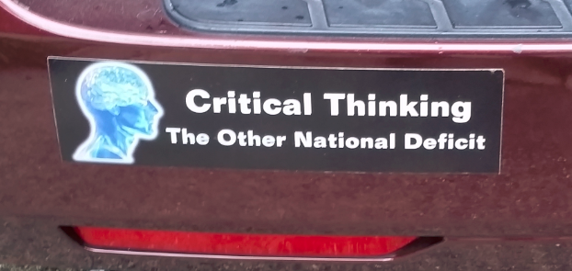
We are not as rational or “evidence-based” as we think
Humans for the most part advocate and pursue what we regard (including unconsciousness influences) as in our interests (I’m using broad definitions of "regard" and “interests”). And that pursuit affects our very perceptions (partly via what we pay attention to), judgment, and what we devote our energies to.

Slide 40
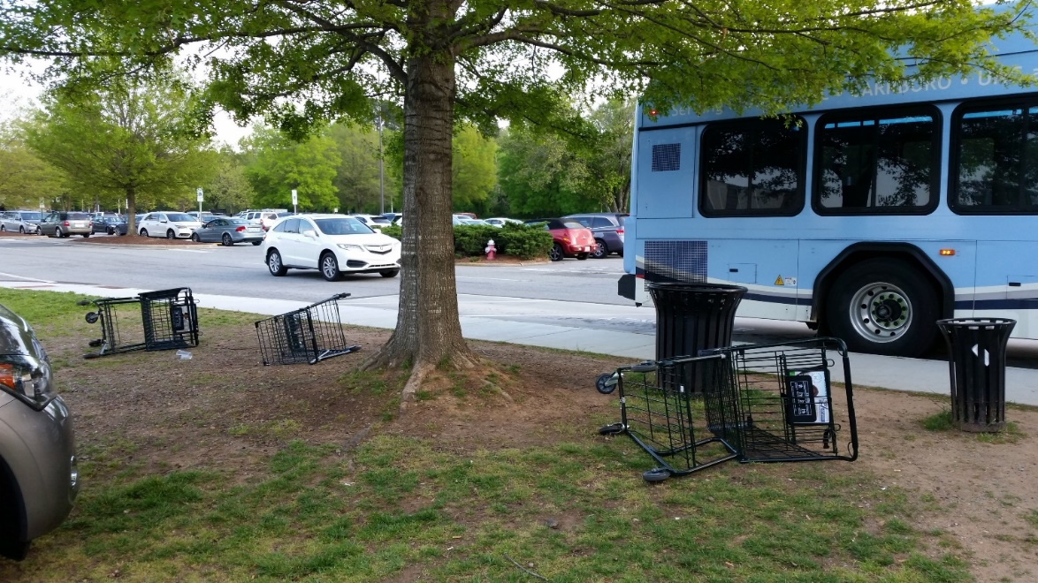
Implications
If society is emergent behavior, we need better agents – intelligent, cooperative, rested, content!
Discontent causes friction and is contagious.
Question: Does an emphasis on disparities / equality, rather than overall public health, generate friction and resistance?

Slide 41
Observing society through the media and daily interactions
Random examples of behavior and public health
Cooperativeness, helpfulness vs corruption, anger, etc.
Rationality, irrationality
Religion
Houston volunteers
Flood insurance
Muncie, IA – opioid use

Slide 42
Grumpiness and lack of sleep
“When people have slept less, it’s a little like looking at the world through dark glasses,” said Janice Kiecolt-Glaser, a longtime relationship scientist and director of the Ohio State Institute for Behavioral Medicine Research. “Their moods are poorer. We’re grumpier. Lack of sleep hurts the relationship.”
Quoted from “Relationship Problems? Try Getting More Sleep”,
Tara Parker-Pope, NY Times, Sept. 4, 2017
https://www.nytimes.com/2017/09/04/well/family/relationship-problems-try-getting-more-sleep.html

Slide 43
Grumpiness and lack of sleep
Couples’ shorter sleep duration related to higher stimulated cytokine production after marital conflict.
People who slept less behaved more negatively and less positively only when their partner had also slept less.
One’s own and one’s partner’s use of emotion regulation strategies during conflict buffered short-sleep-related inflammatory reactivity.
Stephanie J. Wilson, et al. Shortened sleep fuels inflammatory responses to marital conflict: Emotion regulation matters. Psychoneuroendocrinology. May 2017; 79: 74-83
http://www.sciencedirect.com/science/article/pii/S0306453016305169

Slide 44
Election manipulation by Russia
On Twitter, as on Facebook, Russian fingerprints are on hundreds or thousands of fake accounts that regularly posted anti-Clinton messages. Many were automated Twitter accounts, called bots, that sometimes fired off identical messages seconds apart — and in the exact alphabetical order of their made-up names, according to the FireEye researchers. On Election Day, for instance, they found that one group of Twitter bots sent out the hashtag #WarAgainstDemocrats more than 1,700 times.
Quoted from “The Fake Americans Russia Created to Influence the Election”,
Scott Shanes, NY Times, Sept 7, 2017
https://www.nytimes.com/2017/09/07/us/politics/russia-facebook-twitter-election.html

Slide 45
Election manipulation by Russia
Critics say that because shareholders judge the companies partly based on a crucial data point — “monthly active users” — they are reluctant to police their sites too aggressively for fear of reducing that number. The companies use technical tools and teams of analysts to detect bogus accounts, but the scale of the sites — 328 million users on Twitter, nearly two billion on Facebook — means they often remove impostors only in response to complaints.
Quoted from “The Fake Americans Russia Created to Influence the Election”,
Scott Shanes, NY Times, Sept 7, 2017
https://www.nytimes.com/2017/09/07/us/politics/russia-facebook-twitter-election.html

Slide 46
Election manipulation by Russia
Twitter, unlike Facebook, does not require the use of a real name and does not prohibit automated accounts, arguing that it seeks to be a forum for open debate. But it constantly updates a “trends” list of most-discussed topics or hashtags, and it says it tries to foil attempts to use bots to create fake trends. However, FireEye found that the suspected Russian bots sometimes managed to do just that, in one case causing the hashtag #HillaryDown to be listed as a trend.
Quoted from “The Fake Americans Russia Created to Influence the Election”,
Scott Shanes, NY Times, Sept 7, 2017
https://www.nytimes.com/2017/09/07/us/politics/russia-facebook-twitter-election.html

Slide 47
IV. New possibilities

Slide 48
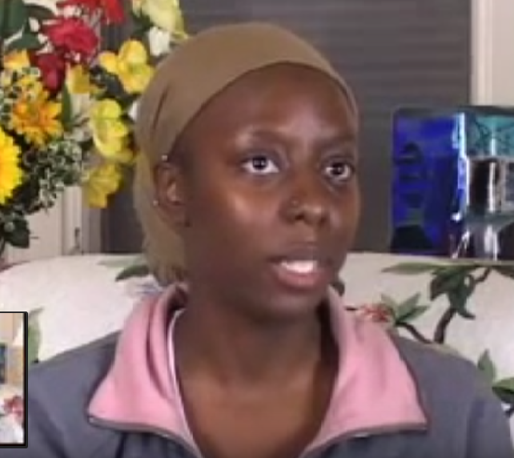
Tasha Daniels describes her experience of the Transcendental Meditation technique and how it helps her deal with stress
(click photo for video)
"Things still happen and don't go as perfectly as I wish they would, it's just the way I respond to it is different. I can be calmer and react to [stress] in a better way."
Notes:
Tasha: The oddest thing for me is that stress still happens it's just the way I deal with it changes. Because I think when I first started Transcendental Meditation I thought, stress will just disappear - no more stress in my life ever again! It's not that stress doesn't happen, things still happen and don't go as perfectly as I wish they would it's just the way I respond to it is different. I have a split second where I stop and can step back from the situation and realize I don't need to, that I can be calmer and react to it in a better way. I think that has probably been the best thing. I mean there is also the whole like, I just feel better, your body just feels better and your sleep is better. All that is good too but for me the biggest thing is that I can handle stress a lot better."

Slide 49
Fred Travis on Transcendental Meditation and brain integration
States of consciousness, types of meditation - 8 min
www.epidemiolog.net/video/epid799c_2016/03-20160426/Excerpt-1018-1804.mp4
Brain diagrams of blood flow, EEG patterns - 5 min
www.epidemiolog.net/video/epid799c_2016/03-20160426/Excerpt-1945-2445.mp4
TC to CC, brain waves in 4-month vs. 8-year meditators - 4+ min
www.epidemiolog.net/video/epid799c_2016/03-20160426/Excerpt-3153-3642.mp4
* Brain integration correlations - TM - 1+ min
www.epidemiolog.net/video/epid799c_2016/03-20160426/Excerpt-5434-5541.mp4
* Brain integration correlations - not TM - 2.5 min
www.epidemiolog.net/video/epid799c_2016/03-20160426/Excerpt-5700-5928.mp4
TM and brain integration - conclusion - 2 min
www.epidemiolog.net/video/epid799c_2016/03-20160426/Excerpt-6062-6228.mp4
[May need to copy-and-paste the link into Chrome]
Notes:
Fred Travis, professor at Maharishi University of Management, is a neuroscientist who has been conducting research on TM for several decades.

Slide 50
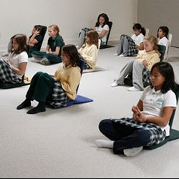
Meditation in the Classroom – The Maharishi School, Fairfield IA (Ken Chawkin, The Edge, Aug 1, 2004)
Dr. Charles Matthews, chairman and former professor of science education at Florida State University: “The students … have the longest attention span of any I have seen in the 30 years of teaching and educational research in public and private schools.”
Julia Herbert, Ed.S., reading consultant in the Washington, D.C., area schools: “… I have never felt such a calm and silent atmosphere in a school of bright, lively, alert children…”
Jill Olsen-Virlee, Iowa Teacher of the Year for 1996 from Marion, Iowa: “Your school was truly an inspiration. The inner peace, the concern for one another, the respect and thirst for wisdom and a holistic approach to children are awesome.”
Notes:
Ken Chawkin, August 1, 2004 http://www.edgemagazine.net/2004/08/meditation-in-the-classroom/

Slide 51
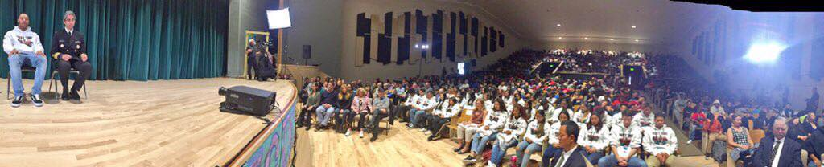
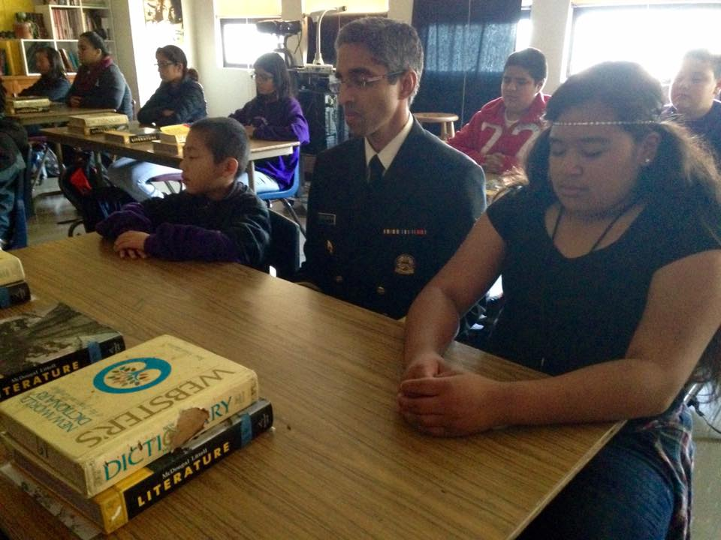
Former Surgeon General Vivek Murthy visits the TM Quiet Time program in San Francisco
Murthy: The "Quiet Time" program has revolutionized schools in San Francisco. Grades are up, detentions/suspensions down, happiness on the rise, violence on the decline. These student and faculty practitioners are teaching us about more than stress management. They are teaching us how to love ourselves and one another.
Notes:
Copied 11/5/2016 from Surgeon General Vivek Murthy's Facebook posts on the Transcendental Meditation Quiet Time program in San Francisco schools (link)
More about the TM/Quiet Time program in Northern California schools:
https://sakai.unc.edu/access/content/user/vschoenb/Public%20Library/Transcendental%20Meditation%20and%20the%20David%20Lynch%20Foundation/TM%20in%20education/Quiet%20Time%20program%20_schools_/San%20Francisco%20schools/

Slide 52
The Maharishi Effect
Among the hundreds of studies of the practice of Transcendental Meditation (TM), there are over 50 studies of individuals or groups practicing the TM and/or TM-Sidhi programs and association with indicators of the larger society’s quality of life, such as indicators of conflict (the Maharishi Effect).

Slide 53
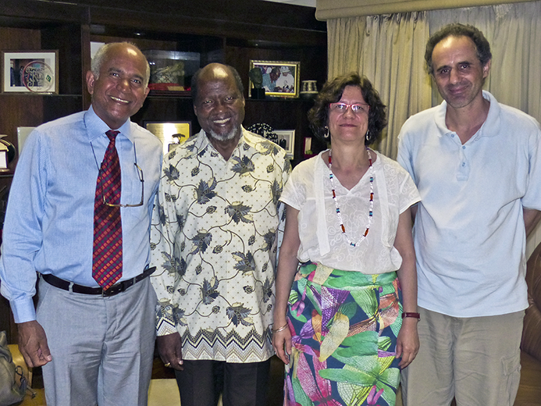
Mozambique President Joachim Chissano credits TM with ending the civil war in that country.
From left to right: Richard Robertson, President Joaquim Chissano, Janine Decot Robertson and Antonio Gonçalves at the Fundaçao Joaquim Chissano in Maputo
http://www.bienfaits-meditation.com/en/the_beatles_and_tm/celebrities/joachim-chissano_en
Notes:
Slide from Antonio Gonçalves

Slide 54
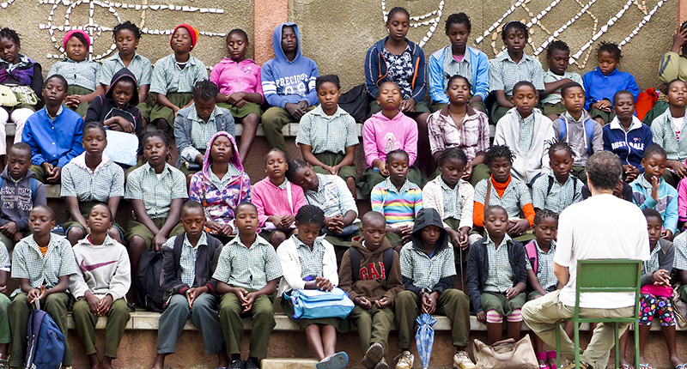
Ntwananu Elementary School, Maputo
All students meditating after the school’s morning assembly
Notes:
Slide from Antonio Gonçalves

Slide 55
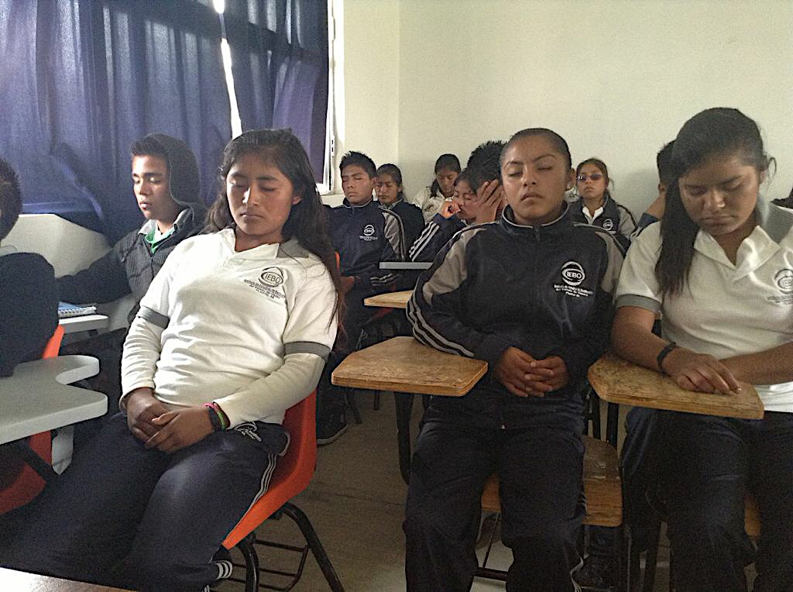
IEBO Ocotepec, Mixteca, Oaxaca
Notes:
Slide from Antonio Gonçalves

Slide 56
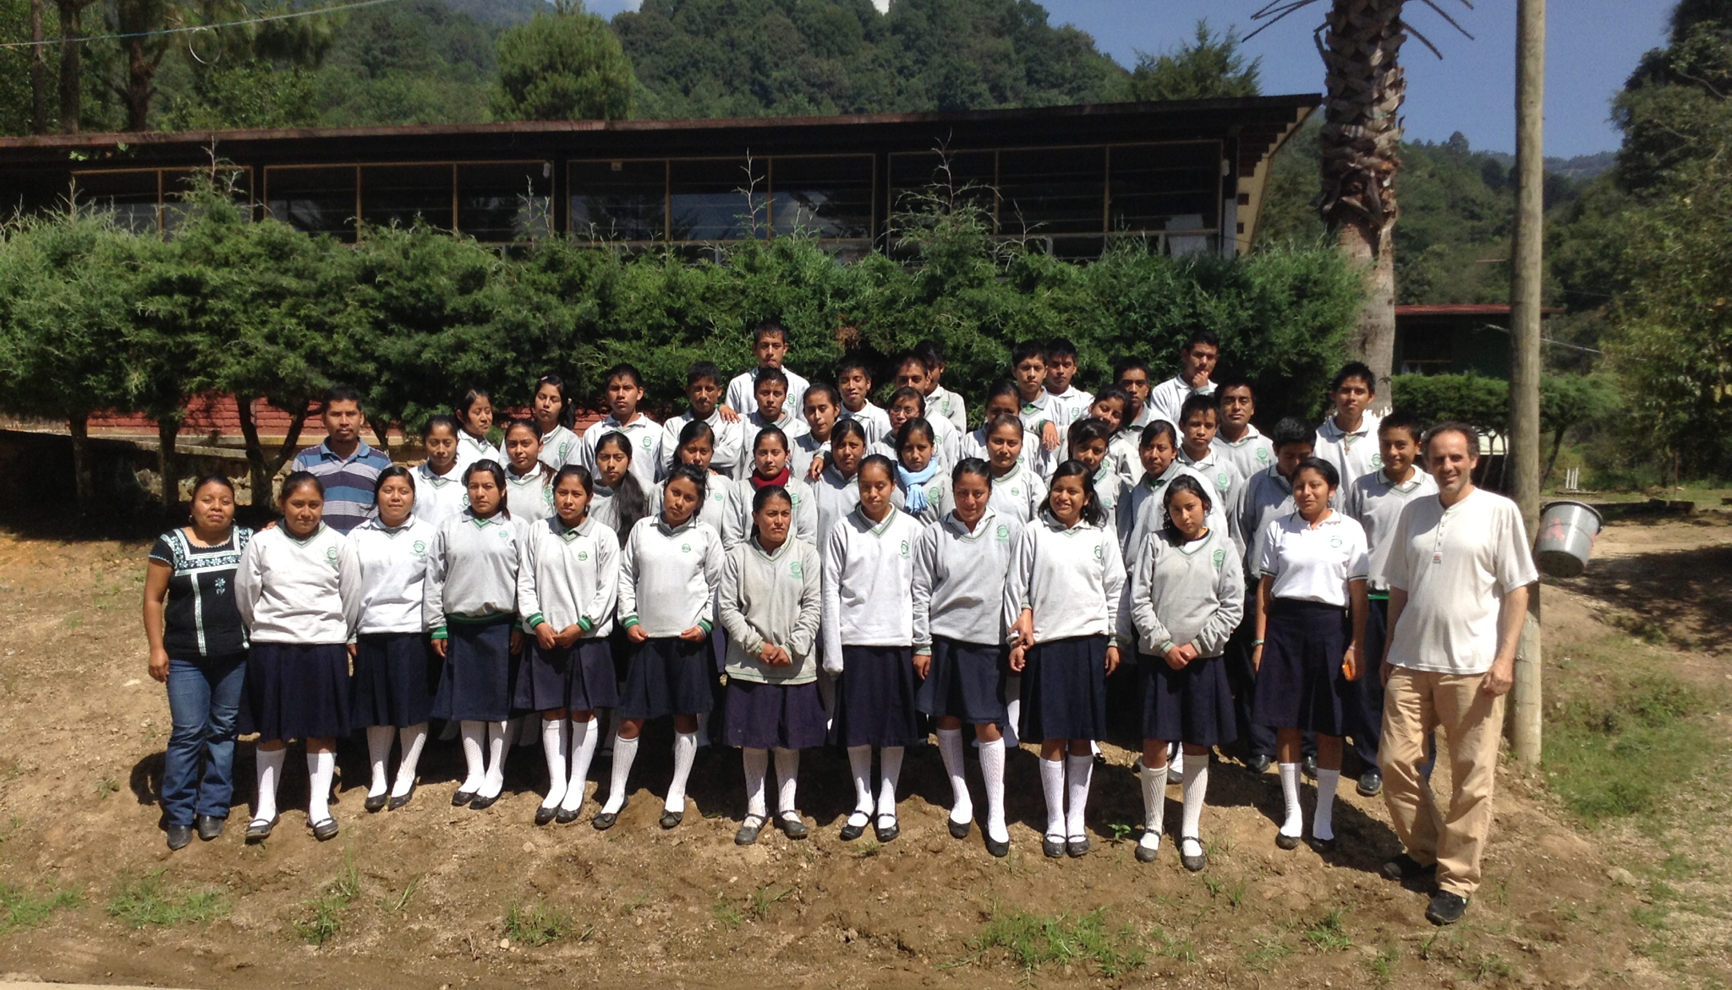
Santa Maria Tepantlali, Sierra Norte, Oaxaca

Slide 57
The Maharishi Effect – Example papers
Orme-Johnson, D. W., C. N. Alexander, J. L. Davies, H. M. Chandler, and W. E. Larimore. “International peace project in the Middle East: The effect of the Maharishi Technology of the Unified Field.” Journal of Conflict Resolution 1988; 32(4):776–812.
Dillbeck, M. C. "Test of a field theory of consciousness and social change: Time series analysis of participation in the TM-Sidhi program and reduction of violent death in the U.S." Social Indicators Research 1990; 22:399–418.
Dillbeck, M. C., and M. V. Rainforth. "Impact assessment analysis of behavioral quality of life indices: Effects of group practice of the Transcendental Meditation and TM-Sidhi program." Proceedings of the American Statistical Association, Social Statistics Section 1996:38–43.
Walton, K. G., K. L. Cavanaugh, and N. D. Pugh. “Effect of group practice of the Transcendental Meditation program on biochemical indicators of stress in non-meditators: A prospective time series study.” Journal of Social Behavior and Personality 2005;17(1):339-376.
See full list and discussion at:
www.truthabouttm.org/documentFiles/20.doc
http://www.truthabouttm.org/truth/societaleffects/critics-rebuttals/

Slide 58
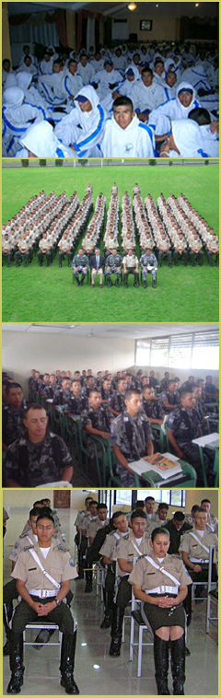
The Maharishi Effect – Invincible Military
Nepal, Ukraine, and several militaries in Latin America are participating
(left: Ecuador: http://www.davidleffler.com/enewsletter/20100703_IDT_News.html)

Slide 59
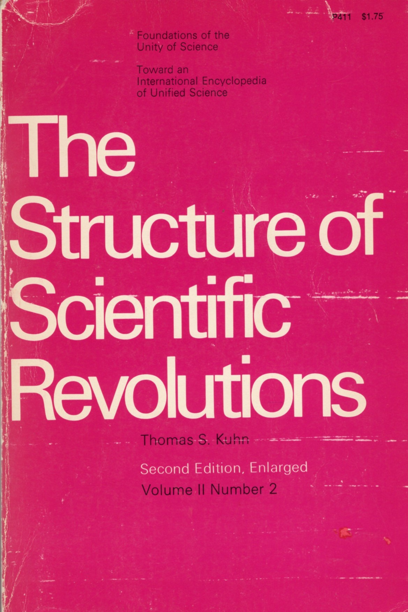
Thomas Kuhn’s The Structure of Scientific Revolutions
“Where the standard account saw steady, cumulative "progress", Kuhn saw discontinuities – a set of alternating ‘normal’ and ‘revolutionary’ phases in which communities of specialists in particular fields are plunged into periods of turmoil, uncertainty and angst. These revolutionary phases – for example the transition from Newtonian mechanics to quantum physics – correspond to great conceptual breakthroughs and lay the basis for a succeeding phase of business as usual.”
Quoted from “Thomas Kuhn: the man who changed the way the world looked at science”, John Naughton, The Guardian, 18 August 2012
https://www.theguardian.com/science/2012/aug/19/thomas-kuhn-structure-scientific-revolutions

Slide 60
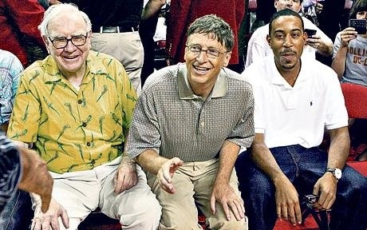
The dinner that cost Bill Gates, Warren Buffett and other celebrities billions
Warren Buffett and Bill Gates. Photo: Getty
Notes:
Tom Leonard, The Telegraph, 06 Aug 2010
http://www.telegraph.co.uk/news/worldnews/northamerica/usa/7929657/The-dinner-that-cost-Bill-Gates-Warren-Buffett-and-other-celebrities-billions.html

Slide 61
It could happen?
“This week … 40 billionaires – worth a combined $230 billion (£145 billion) – signed a "giving pledge" to donate at least 50 per cent of their wealth to good causes. It is a remarkable act of noblesse oblige, even in a country whose tradition of philanthropy is the strongest in the industrialised world.”
www.telegraph.co.uk/news/worldnews/northamerica/usa/7929657/The-dinner-that-cost-Bill-Gates-Warren-Buffett-and-other-celebrities-billions.html

Slide 62
“it all started with a dinner”
“… it all started with a dinner – a secret one envisaged by Warren Buffett, organised by Bill and Melinda Gates, and hosted by David Rockefeller … at the elegant and discreet President's House at Rockefeller University in New York on May 5 last year.” By Tom Leonard
www.telegraph.co.uk/news/worldnews/northamerica/usa/7929657/The-dinner-that-cost-Bill-Gates-Warren-Buffett-and-other-celebrities-billions.html
Notes:
Downloaded 9/10/2010

Slide 63
UNC conferences/webcasts
Coming Sept 29th: The Courage to Lead: Scholar-Activism and Health Equity in Turbulent Times, 23rd National Health Equity Research Webcast. http://go.unc.edu/nherw
Camara Jones, Andrew Curley, Paul Cuadros,
Moderator: Wizdom Powell
Coming Feb 23: Reclaiming the Narrative, 39th Annual Minority Health Conference with interactive webcast of keynote lecture.
Past webcasts at www.minority.unc.edu/resources/webcasts/

Slide 64
Thank you!
Please visit my “virtual library” at http://go.unc.edu/sjae
and my other pages at
http://go.unc.edu/vjs

